Slide 1
Insight School of Minnesota (ISMN)
EDTC650
Virtual School Case Study
Joanne Deitsch
October 31, 2017
Notes:
Welcome to my case study of the Insight School of Minnesota (ISMN).

Slide 2
Website & Stakeholders
ISMN’s Home Page: http://mn.insightschools.net/
The school’s site is primarily a sales tool geared to encourage enrollment. The content focuses on reasons why students should enroll and lack resources for other stakeholders.
Image Attribution: https://vimeo.com/150227133
Notes:
Let’s start out by talking about the school’s main website. We’ll explore the content and how it helps prospective parents and students as well as teachers.

Slide 3
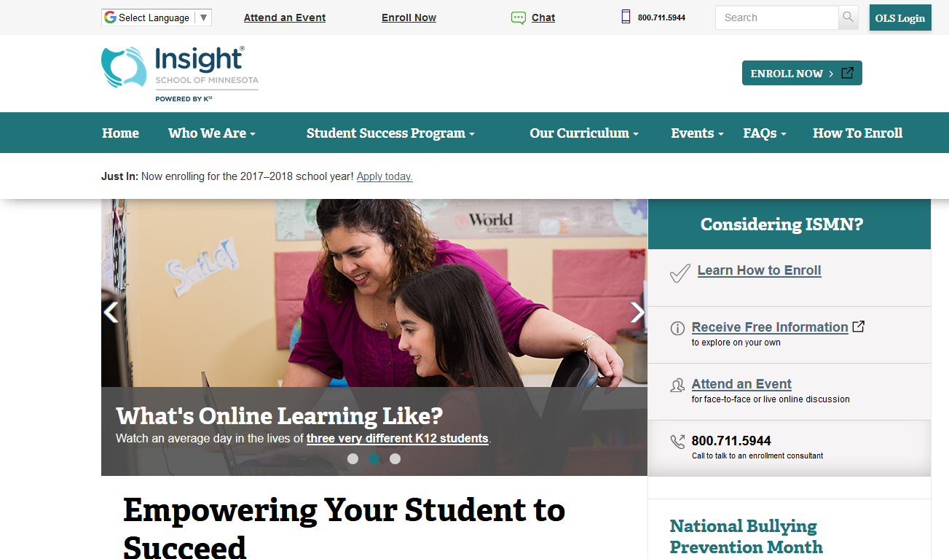
For Prospective Parents/Students
(ISMN, 2017b)
Notes:
The home page of the ISMN is really geared as a sales tool to prospective parents and students (ISMN, 2017b). There are multiple opportunities for prospective parents and students to: 1) attend an event about the school, 2) enroll, 3) chat with an enrollment counselor, or 4) call an enrollment counselor. The areas in the red callouts on this screen represent 11 sales opportunities (ISMN, 2017b).

Slide 4
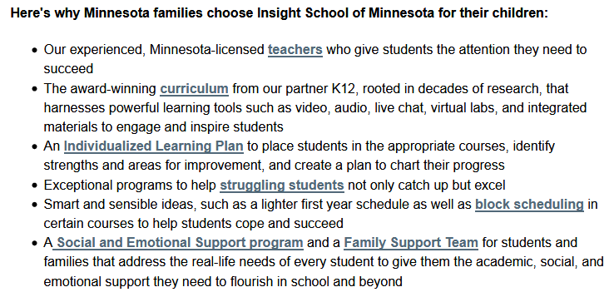
For Prospective Parents/Students
(ISMN, 2017j)
Notes:
The Who We Are page provides further information that can help prospective students and parents make a decisions about whether or not to attend the school (ISMN, 2017j). Hyperlinks on this page lead to other pages (ISMN, 2017j). The Our Teachers pages does not provide a list of teachers but rather the fact that they work remotely as well as how middle school and high school teachers work with families enrolled in the program (ISMN, 2017f). The Our Curriculum page provides a high level discussion about the school’s award winning curriculum that is tailored to the student’s individualized learning plan (ISMN, 2017e). Finally, the Individualized Learning Plan (ILP) page gives a high level discussion of how this plan is based on the student’s assessment and serves as a roadmap for the students in their secondary and post-secondary careers (ISMN, 2017c).

Slide 5
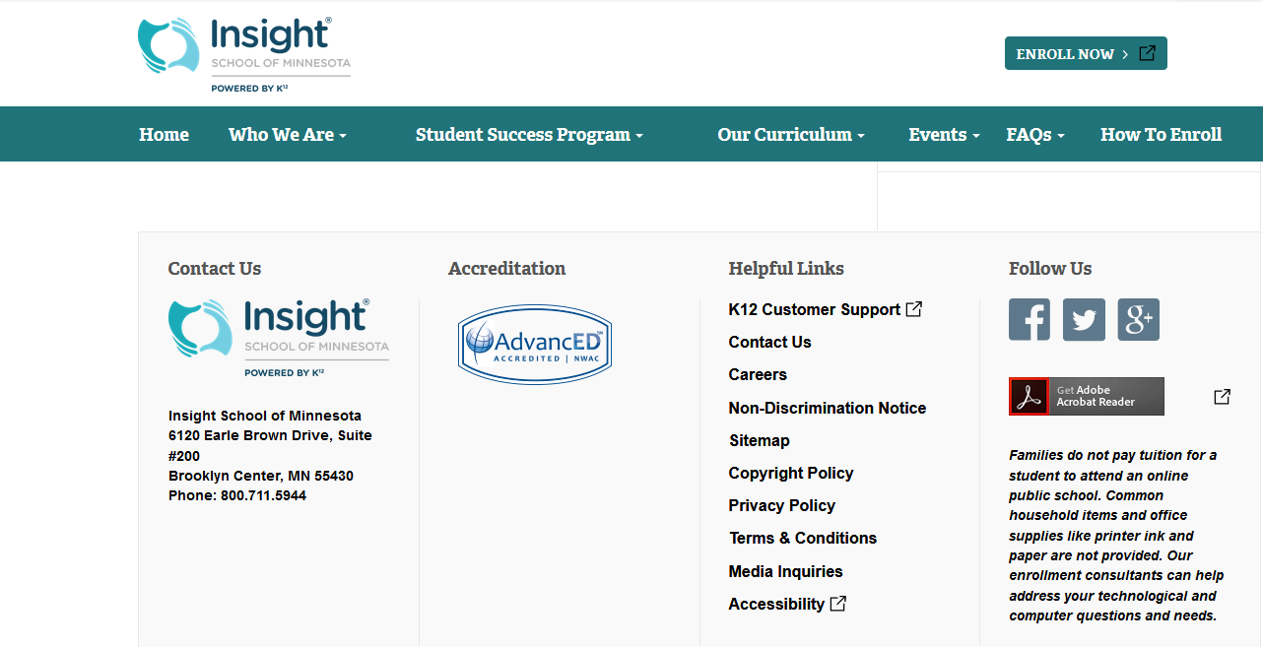
For Teachers
(ISMN, 2017b)
Notes:
The only resources that could be found for teachers on the main website are links for customer support and careers (ISMN, 2017b). There may be more resources for teachers who actually work for the school in another portal or in the Online School (OLS). However, these resources are not available on the public internet.

Slide 6
Mission
“Engage, educate and empower ALL students to reach their full potential in their educational and professional goals” (ISMN, 2017j, para. 4).
Image Attribution: https://vimeo.com/159366218
Notes:
Let’s talk about the mission of ISMN and how well it fulfills that mission.

Slide 7
Mission
“The mission of Insight School of Minnesota is to engage, educate and empower ALL students to reach their full potential in their educational and professional goals” (ISMN, 2017j, para. 4).
Notes:
ISMN’s mission is to “engage, educate and empower all students to reach their full potential in their educational and professional goals” (ISMN, 2017j, para. 4).

Slide 8
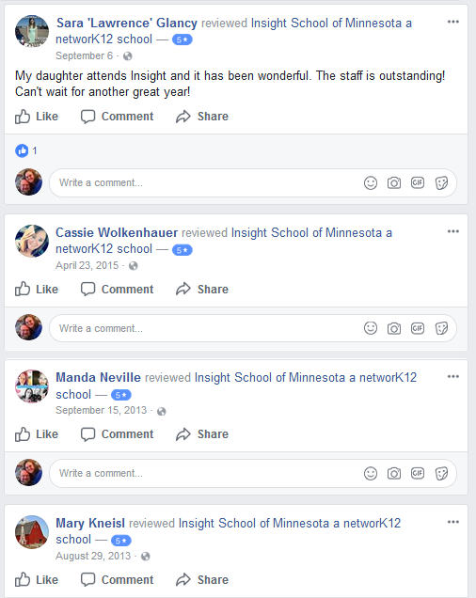
Delivering on the Mission: Anecdotal
Facebook reviews
Four students give this school five stars out of five possible stars (ISMN, 2017h)
Notes:
How well is the ISMN delivering on it’s mission? If we look at Facebook reviews, we find that four students give this school a ranking of five out of five stars (ISMN, 2017h).

Slide 9
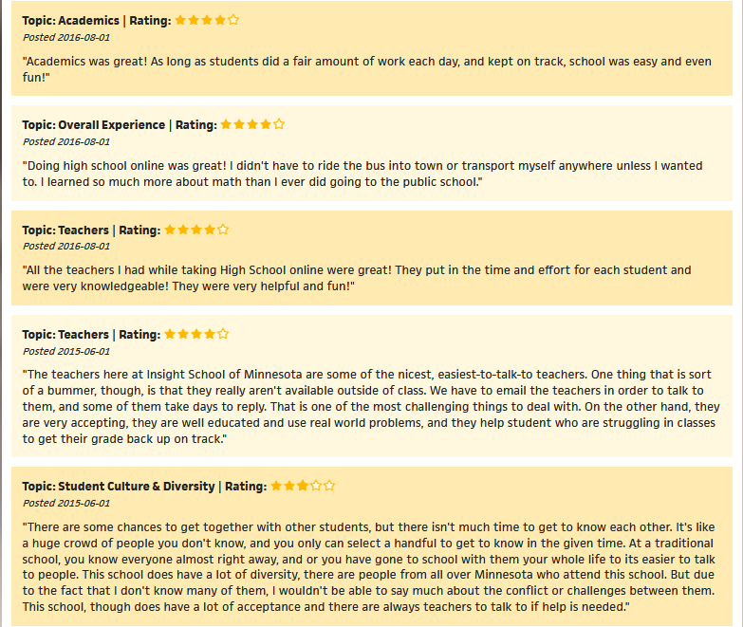
Delivering on the Mission: Anecdotal
Century 21 Site
4 reviews: four stars
2 reviews: three stars
1 review: two stars
(Century 21, 2017a, 2017b)
Notes:
Further anecdotal evidence can be found on a Century 21 site, a realty site. Out of seven reviews, four reviews give this school four stars, two reviews give this school three stars, and one review gives this school two stars (Century 21, 2017a, 2017b).

Slide 10
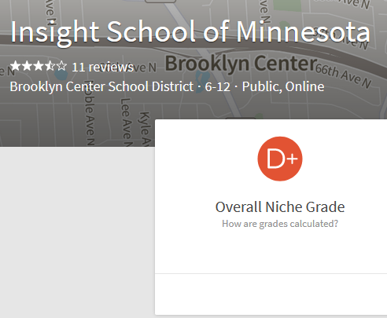
Delivering on the Mission: Rankings
(Homefacts.com, 2017)
(Niche.com, Inc., 2017)
Notes:
There are other sources whose reviews are not very complementary. Two sites give ISMN very unflattering overall scores of D+ (Niche.com Inc., 2017; Homefacts.com, 2017).

Slide 11
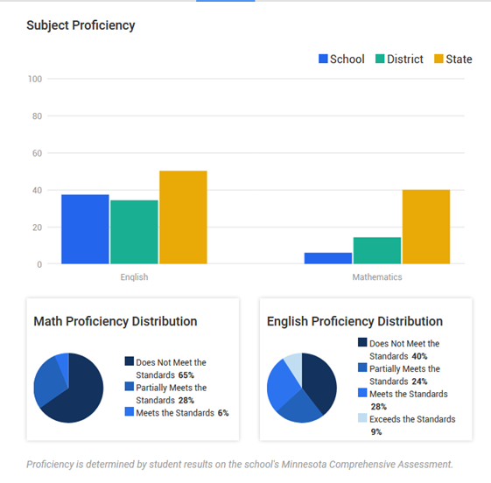
Delivering on the Mission: Rankings
(U.S. News & World Report L.P., 2017)
Notes:
Most compelling is a review by US News that refers to student results from the Minnesota Comprehensive Assessment in the 2014-2015 school year (U.S. News & World Report L.P., 2017). Only 6% of students meet proficiency standards in Math (U.S. News & World Report L.P., 2017). Only 37% met or exceeded English proficiency standards (U.S. News & World Report L.P., 2017).

Slide 12
Organizational Structure
The school is headed by John Huber. Teachers, support staff, and members of the Family Academic Support team also are part of the ISMN.
Image Attribution: https://commons.wikimedia.org/wiki/File:Lorimerlite_framework.JPG
Notes:
Details regarding the organizational structure of ISMN are scarce on the public internet. In this section, various personnel, teachers, support staff, and the Family Academic Support team are discussed.

Slide 13
Personnel
Name | Role | Reference
John Huber | Head of School | http://newsroom.k12.com/insight-school-of-minnesota-opens-enrollment-for-2017-18-school-year/
Donna Savarese | Director of Corporate Communications | http://www.businesswire.com/news/home/20170605006245/en/Insight-School-Minnesota-Hold-Graduation-Ceremony-June/?feedref=JjAwJuNHiystnCoBq_hl-Q-tiwWZwkcswR1UZtV7eGe24xL9TZOyQUMS3J72mJlQ7fxFuNFTHSunhvli30RlBNXya2izy9YOgHlBiZQk2LOzmn6JePCpHPCiYGaEx4DL1Rq8pNwkf3AarimpDzQGuQ%3D%3D&utm_source=dlvr.it&utm_medium=twitter
Sheri McKeever | Special Education Teacher | http://www.satprnews.com/2017/09/07/insight-school-of-minnesota-kicks-off-2017-2018-school-year/
Notes:
John, Donna, and Sheri were the only personnel that could be found on public internet sites.

Slide 14
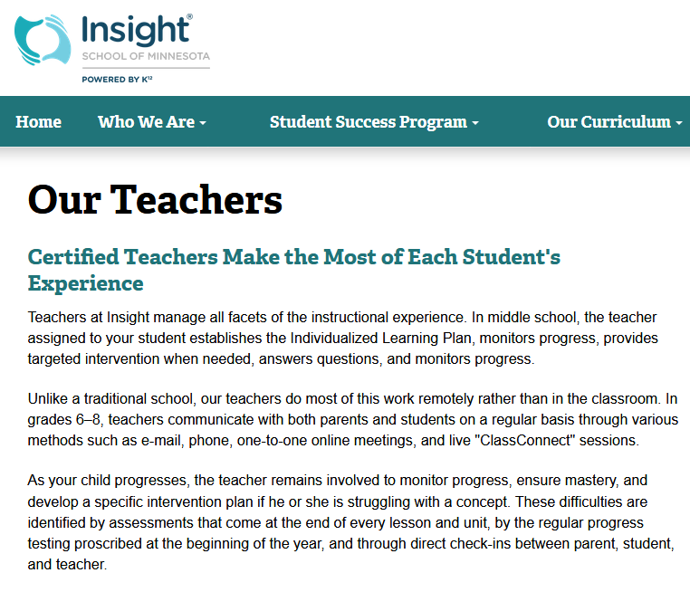
Teachers
(ISMN, 2017f)
Notes:
Teachers certified by the state of Minnesota are another part of the organization at ISMN (ISMN, 2017f).

Slide 15
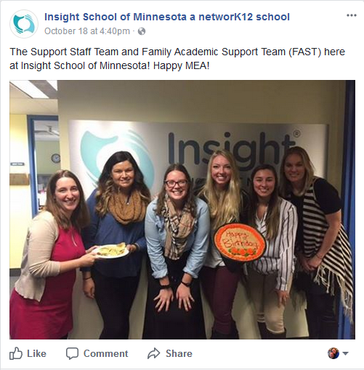
Support Staff and Family Academic Support Team
https://www.facebook.com/InsightMinnesota?_ga=1.208400155.820318007.1447172363
Notes:
Finally, support staff and the Family Academic Support Team are also members of ISMN (ISMN, 2017a).

Slide 16
Regulatory Environment
Image Attribution: https://en.wikipedia.org/wiki/United_States_Department_of_Education
Notes:
Let’s turn our attention next to the Regulatory Environment.

Slide 17
Program Details
Tuition-free (Business Wire Inc., 2017)
Full- and part-time online public school program (Business Wire Inc., 2017)
Part of the Brooklyn Center School District in Minnesota (Business Wire Inc., 2017)
Notes:
ISMN is a tuition-free, full- and part-time online public school program (Business Wire Inc., 2017). This school is part of the Brooklyn Center School District in the Minnesota public school system (Business Wire Inc., 2017). The curriculum is provided by K12, Inc (Business Wire Inc., 2017).

Slide 18
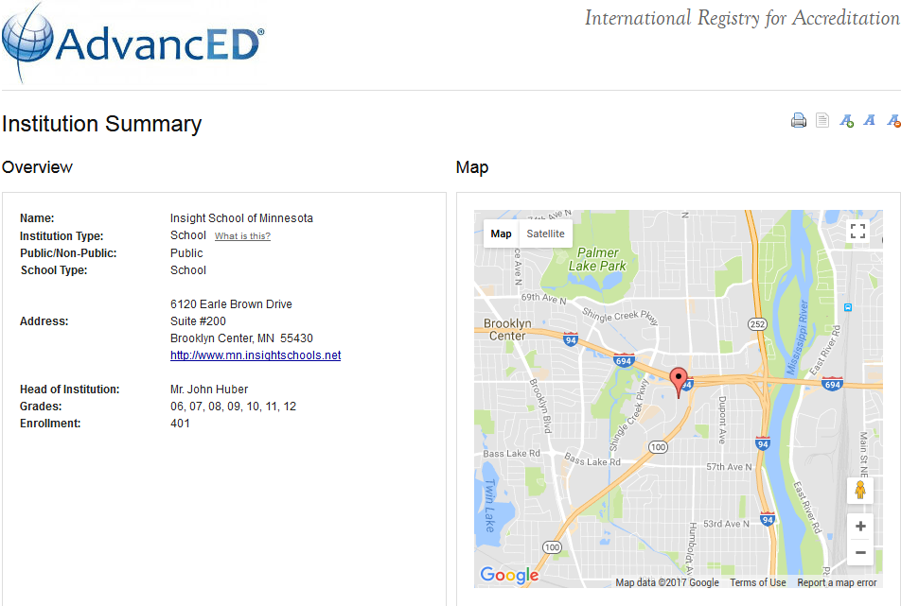
Accreditation
(Advanced Education, Inc., 2017)
Notes:
ISMN is accredited by AdvanceED (Advanced Education, Inc., 2017).

Slide 19
Scope of Offerings
Subjects
Support services include:
Technical support
Family Academic Support Team
Social and Emotional Learning
Clubs
Image Attribution: https://www.flickr.com/photos/internetarchivebookimages/14783131202/
Notes:
In this section we’ll cover the subjects offered by the school and support services.

Slide 20
Subjects
Reading
Literature
Writing
Math
Science
Social Studies
Spanish
Electives
(ISMN, 2017g)
Notes:
The subjects covered ISMN include reading, literature, writing, math, science, social studies, Spanish, and electives (ISMN, 2017g). In addition, “the remediation program includes content for high school high–stakes exam readiness, so students can be thoroughly prepared for critical exams” (ISMN, 2017g, para. 3).

Slide 21
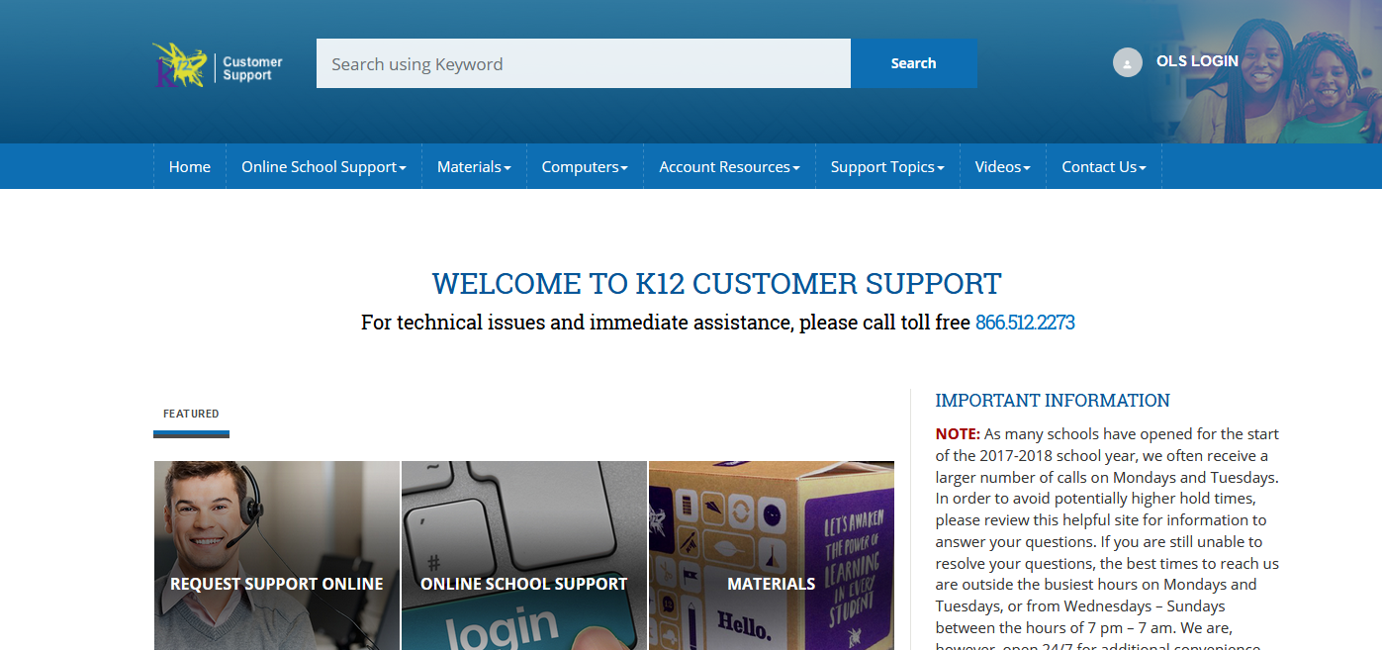
Support Services: Technical Support
(K12 Inc., 2016)
Notes:
Technical support is provided by K12 Inc. (K12 Inc., 2016). Students can call a toll-free line or submit an online form to get help with course print materials and computer technical issues (K12 Inc., 2016).

Slide 22
Support Services: Family Academic Support Team
https://www.facebook.com/InsightMinnesota?_ga=1.208400155.820318007.1447172363
Notes:
The Family Academic Support Team includes a licensed social worker and other family support personnel to help students stay on track through early interventions, wrap-around supports, and linking families to school and community based resources (ISMN, 2017a).

Slide 23
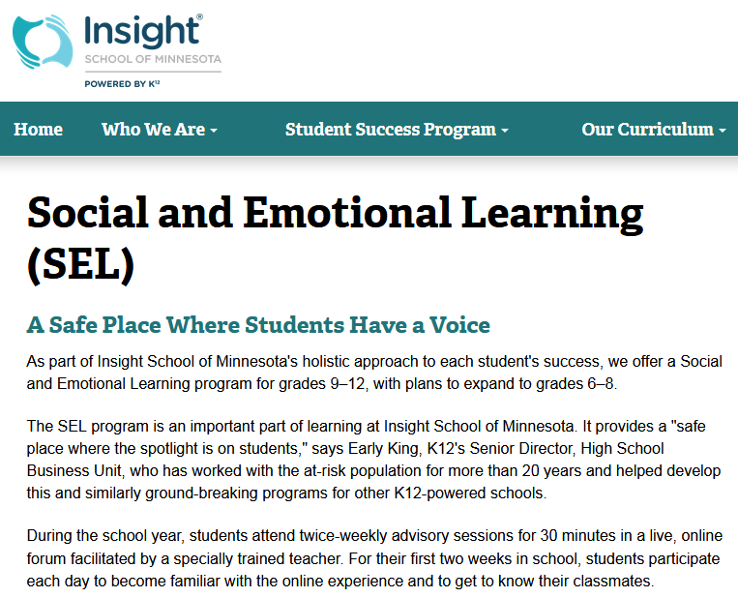
Support Services: Social and Emotional Learning
(ISMN, 2017i)
Notes:
Students who participate in the Social and Learning program attend twice-weekly advisory sessions for 30 minutes in a live, online forum facilitated by a specially trained teacher (ISMN, 2017i). The goals of these programs are to help grow student’s self-awareness, social awareness, relationship building, and responsible decision-making skills (ISMN, 2017i).

Slide 24
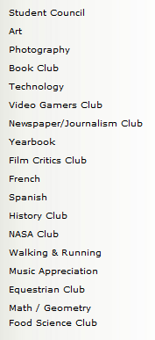
Support Services: Clubs
(Macluke170, 2008)
Notes:
A student was kind enough to post ISMN clubs in a blog post (Macluke170, 2008).

Slide 25
Student Body
Targets struggling students in grades 6-12
Student population primarily white students, 60% Female
Enrollment between 295-459 students
Image Attribution: https://www.google.com/imgres?imgurl=https%3A%2F%2Fmedia.defense.gov%2F2012%2FOct%2F16%2F2000105914%2F-1%2F-1%2F0%2F121004-F-AI558-006.JPG&imgrefurl=http%3A%2F%2Fwww.aviano.af.mil%2FNews%2FArticle-Display%2FArticle%2F280638%2Fonline-tutors-help-students-learn-247%2F&docid=HrHJMCtVIlPfhM&tbnid=4ObqvLthQALwOM%3A&vet=10ahUKEwi4mMrysvvWAhXE64MKHT-YDIUQMwheKAMwAw..i&w=4452&h=3092&bih=959&biw=1800&q=online%20students&ved=0ahUKEwi4mMrysvvWAhXE64MKHT-YDIUQMwheKAMwAw&iact=mrc&uact=8
Notes:
Finally, we’ll turn our attention to the student body at the ISMN. What they can expect, the target student population, student population, and enrollment statistics are covered.

Slide 26
What Students Can Expect
Students at ISMN:
Can attend school from the safety of home (ISMN, 2017d)
Can focus on their studies without distractions and without peer pressure (ISMN, 2017d)
Receive the help of state-certified teachers, counselors, and a parent or other adult "Learning Coach" to provide support (ISMN, 2017d)
Notes:
Students who attend ISMN attend school from their home without the distractions and peer pressure (ISMN, 2017d). State-certified teachers, counselors, and a learning coach (usually a parent) provide support (ISMN, 2017d).

Slide 27
Target Student Population
Per John Huber, the student population that Insight School is targeting are:
Struggling students grades 6-12 (ISMN, 2017d) “A struggling student may be one who has failed certain courses, is bored or turned-off by school, misses school days, feels unsafe at school, or perhaps has received suspensions or been left back” (ISMN, 2017d, para. 2)
Notes:
The ISMN targets struggling students in grades 6-12 (ISMN, 2017d). These students “may be one who has failed certain courses, is bored or turned-off by school, misses school days, feels unsafe at school, or perhaps has received suspensions or been left back” (ISMN, 2017d, para. 2).

Slide 28
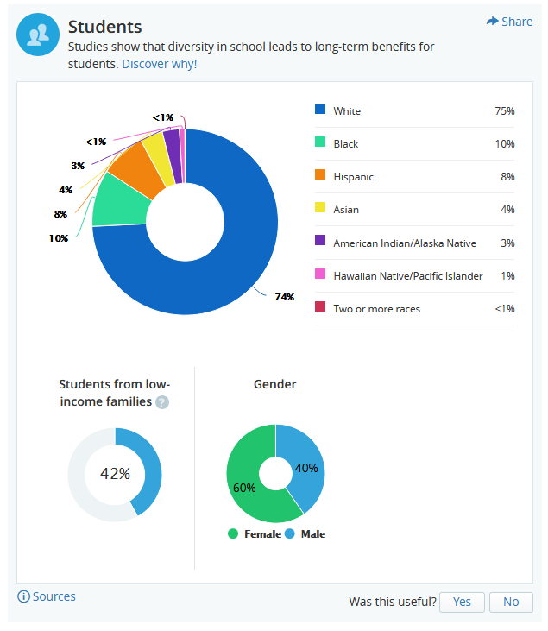
Student Population
(GreatSchools.org, 2017)
Notes:
The student population is predominately white (GreatSchools.org, 2017). 42% of students are from low-income families (GreatSchools.org, 2017). 60% of students are female (GreatSchools.org, 2017).

Slide 29
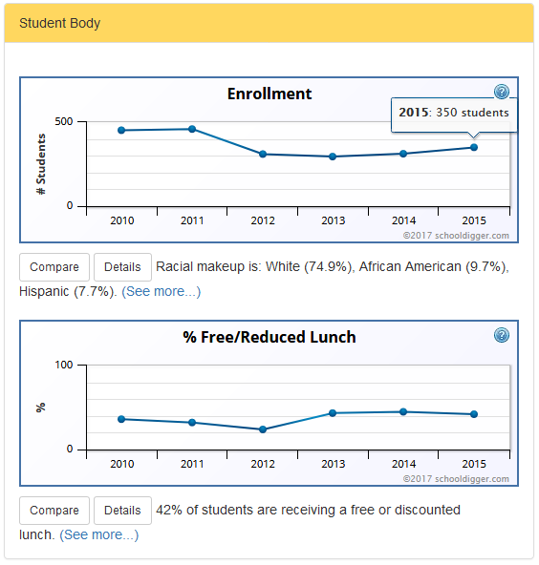
Enrollment 2010-2015
(Schooldigger.com, 2017)
Notes:
Enrollment statistics for ISMN from 2010 through 2015 show a downward trend (Schooldigger.com, 2017). Enrollment started around 450 students in 2010 & 2011 (Schooldigger.com, 2017). The lowest enrollment was in 2013 with 295 students (Schooldigger.com, 2017). Enrollment in 2015 was 350 students (Schooldigger.com, 2017).

Slide 30
How Effective is the Home Page?
(ISMN, 2017b)
Notes:
ISMN’s home page is primarily a sales tool geared to encourage enrollment. The content focuses on reasons why students should enroll and lack meaningful resources for other stakeholders. Students can log into the Online School (OLS) from the button called out in red (ISMN, 2017b). We covered earlier that teacher resources appear to be confined to a few hyperlinks at the bottom of the page.

Slide 31
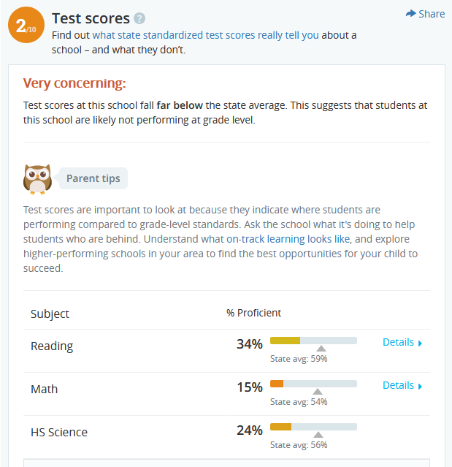
How Well Does ISMN Deliver?
Per Minnesota Department of Education, 2016:
34% Reading
15% Math
24% High School Science
(GreatSchools.org, 2017)
Notes:
Since ISMN targets struggling student populations it is easy to assume that these students are not high performing. Regardless, the scores we see in this presentation does not reflect well on the quality of teaching and support provided by ISMN (GreatSchools.org, 2017). There also seems a lack of pride in the school – the head of school, John Huber is the only easily found name in relation to the school. All other members of the organization are discussed in generic terms as if “teacher” or “support” personnel are easily replaceable widgets that do not contribute to a school’s success.
A final comment from a student who attended ISMN: “"I don't feel there was really anything specific that the teachers or administration did to try and prepare me for college or life after high school. The simple fact of the way the school works in terms of deadlines and schedules was what probably helped me the most. I had to learn how to effectively manage my time with few promptings or deadlines and learn how to teach myself the material I needed to know” (Century21, 2017b, para. 2).

Slide 32
References [1 of 5]
Advanced Education, Inc. (2017). Institution summary. Retrieved October 30, 2017, from http://www.advanc-ed.org/oasis2/u/par/accreditation/summary?institutionId=54044
Business Wire Inc. (2017). Insight school of Minnesota to hold graduation ceremony on June 10th [Web Page]. Retrieved October 30, 2017, from http://www.businesswire.com/news/home/20170605006245/en/Insight-School-Minnesota-Hold-Graduation-Ceremony-June/?feedref=JjAwJuNHiystnCoBq_hl-Q-tiwWZwkcswR1UZtV7eGe24xL9TZOyQUMS3J72mJlQ7fxFuNFTHSunhvli30RlBNXya2izy9YOgHlBiZQk2LOzmn6JePCpHPCiYGaEx4DL1Rq8pNwkf3AarimpDzQGuQ%3D%3D&utm_source=dlvr.it&utm_medium=twitter

Slide 33
References [2 of 5]
Century 21. (2017a). Insight school of Minnesota [Web Page]. Retrieved October 30, 2017, from https://www.century21.com/schools/55430-minneapolis-mn-schools/insight-school-of-minnesota/O5700084570-LZ55430
Century 21. (2017b). Insight school of Minnesota, Page 2 [Web Page]. Retrieved October 30, 2017, from https://www.century21.com/schools/55430-minneapolis-mn-schools/insight-school-of-minnesota/O5700084570-LZ55430#rpage=2
GreatSchools.org. (2017). Insight school of Minnesota [Web Page]. Retrieved October 30, 2017, from https://www.greatschools.org/minnesota/brooklyn-center/5639-Insight-School-Of-Minnesota/
Homefacts.com. (2017). Insight school of Minnesota [Web Page]. Retrieved October 30, 2017, from https://www.homefacts.com/schools/Minnesota/Hennepin-County/Brooklyn-Center/Insight-School-Of-Minnesota.html

Slide 34
References [3 of 5]
ISMN. (2017a). Family academic support team [Web Page]. Retrieved October 30, 2017, from http://mn.insightschools.net/student-success-program/family-academic-support-team.htm
ISMN. (2017b). Home [Web Page]. Retrieved October 30, 2017, from http://mn.insightschools.net/
ISMN. (2017c). Individualized Learning Plan (ILP) [Web Page]. Retrieved October 30, 2017, from http://mn.insightschools.net/student-success-program/individualized-learning-plan-ilp.html
ISMN. (2017d). Letter from our head of school [Web Page]. Retrieved October 30, 2017, from http://mn.insightschools.net/who-we-are/letter-our-head-school.html
ISMN. (2017e). Our curriculum [Web Page]. Retrieved October 30, 2017, from http://mn.insightschools.net/our-curriculum.html

Slide 35
References [3 of 5]
ISMN. (2017f). Our teachers [Web Page]. Retrieved October 30, 2017, from http://mn.insightschools.net/who-we-are/our-teachers.html
ISMN. (2017g). Remediation programs [Web page]. Retrieved October 30, 2017 from http://mn.insightschools.net/student-success-program/remediation-programs.html
ISMN. (2017h). Reviews [Facebook page]. Retrieved October 30, 2017 from https://www.facebook.com/pg/InsightMinnesota/reviews/?ref=page_internal
ISMN. (2017i). Social and emotional learning (SEL) [Web Page]. Retrieved October 30, 2017, from http://mn.insightschools.net/student-success-program/social-and-emotional-learning-sel.html
ISMN. (2017j). Who we are [Web Page]. Retrieved October 30, 2017, from http://mn.insightschools.net/who-we-are.html

Slide 36
References [4 of 5]
K12 Inc. (2016). Welcome to K12 customer support [Web Page]. Retrieved October 30, 2017, from https://www.help.k12.com/s/
Macluke170. (2008, December 11). Insight school clubs [Blog Post]. Retrieved October 30, 2017, from https://insightschool.wordpress.com/page/2/
Niche.com Inc. (2017). Insight school of Minnesota [Web Page]. Retrieved October 30, 2017, from https://www.niche.com/k12/insight-school-of-minnesota-brooklyn-center-mn/
Schooldigger.com. (2017). Insight school of Minnesota [Web Page]. Retrieved October 30, 2017, from https://www.schooldigger.com/go/MN/schools/0624004306/school.aspx

Slide 37
References [5 of 5]
U.S. News & World Report L.P. (2017). Insight school of Minnesota test scores [Web Page]. Retrieved October 30, 2017, from https://www.usnews.com/education/best-high-schools/minnesota/districts/brooklyn-center-school-district/insight-school-of-minnesota-10709/test-scores

