Slide 1
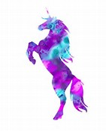
Information Literacy
Paraphrasing & Quoting
M
U
Notes:
This course is part of the Information Literacy series. Today’s lesson is one paraphrasing and quoting.
[This Powerpoint has animations. Whenever you see text that is underlined, click the mouse to activate the next animation]

Slide 2
Currency
Authority
Relevancy
Notes:
We recommend using the CAR Method when evaluating research sources. Determine the currency, authority, and relevancy of the information

Slide 3
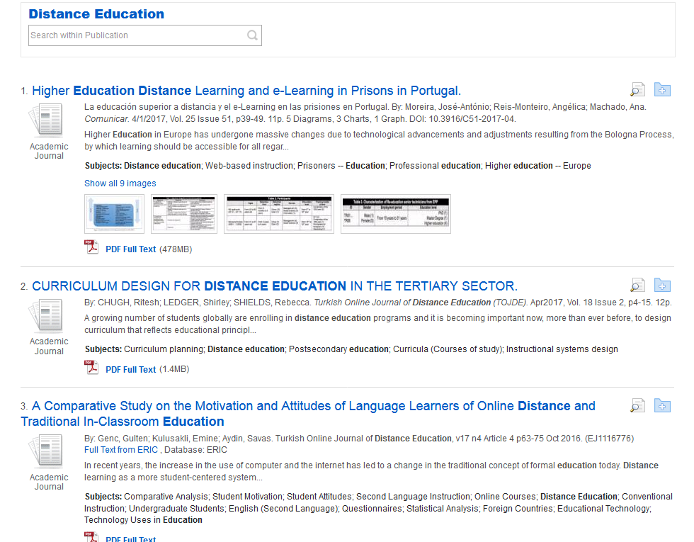
Currency
Authority
Relevancy
Notes:
You should question the currency of the information you find, especially if your topic requires the most recent information. On this page we see articles that were written very recently.

Slide 4
Currency
Authority
Relevancy
Notes:
We also need to consider the authority. You need to consider the following questions: How authoritative is the publication source? What are the credentials of the author? Are there any other sources that confirm or support the author’s material?

Slide 5
Currency
Authority
Relevancy
Notes:
Finally, we also need to consider the relevancy of the material. The questions you need to consider: Does the source relate to your research question? Is the information at an appropriate level?

Slide 6
Getting to the Main Ideas
Abstract
Introduction
Conclusion
Topic Sentences
Notes:
When getting to the main ideas in an article the abstract, introduction, conclusion are excellent resources. For articles without these sections, skimming the topic sentences of the article is another excellent way to understand the main ideas.

Slide 7
What are the main ideas?
ABSTRACT
Distance education system of Allama Iqbal Open University (AIOU), Pakistan mostly depends on the idea of learning through print material and other media such as television, radio, online CDs etc. For conducting this research study, emphasis was on the evaluation of the self-instructional print materials to be used in distance learning system of this university. Applying the survey method in present study the opinions regarding the quality and quantity of print material were gathered from the students and tutors at Intermediate level of education of AIOU. While focusing the quality parameters of self-instruction such as transactional, stylistic and structural (local, national and global) questionnaire for distant learners and tutors was developed. Data was collected through this questionnaire and mean score was used to analyze the data. Through this analysis, it was found that self-instructional print material of Intermediate level needs to be improved while focusing the needs, demands and psychology of the learners. It was also concluded that currently this material is just imparting the knowledge which lacks development of skills and behavior modification. Overall it was recommended that university faculty must focus on the revision and improvement of the self-instructional print material for making it attractive, interactive, effective and communicative.
Notes:
Read this abstract and determine which sentences encompass the main ideas. Proceed to the next slide to see the highlights for the main ideas in this abstract.

Slide 8
What are the main ideas?
ABSTRACT
Distance education system of Allama Iqbal Open University (AIOU), Pakistan mostly depends on the idea of learning through print material and other media such as television, radio, online CDs etc. For conducting this research study, emphasis was on the evaluation of the self-instructional print materials to be used in distance learning system of this university. Applying the survey method in present study the opinions regarding the quality and quantity of print material were gathered from the students and tutors at Intermediate level of education of AIOU. While focusing the quality parameters of self-instruction such as transactional, stylistic and structural (local, national and global) questionnaire for distant learners and tutors was developed. Data was collected through this questionnaire and mean score was used to analyze the data. Through this analysis, it was found that self-instructional print material of Intermediate level needs to be improved while focusing the needs, demands and psychology of the learners. It was also concluded that currently this material is just imparting the knowledge which lacks development of skills and behavior modification. Overall it was recommended that university faculty must focus on the revision and improvement of the self-instructional print material for making it attractive, interactive, effective and communicative.
Notes:
Let’s do another exercise

Slide 9
What are the main ideas?
Since the development of MOOC platform is still in the initial stage, it is very urgent to develop learning resources and optimize teacher resources. Continuous enrichment of learning resources will lead to expansion of learners’ learning breadth. The precondition for effective implementation of the MOOC-based distance education mode is closely related to the MOOC resource library. The value of MOOC platform can be better exerted only through continuously expanding superior teaching resources and improving course resource networks. Furthermore, students’ low adaption to the MOOC-based distance education mode cannot be ignored. Cultivation of students’ habit of independent study online and adaption to participative teaching are also the foundation for extensive application of the MOOC-based distance education mode. Students can share learning experience through social networks, and teachers can establish interactive teaching space, so that both parties can gradually adapt to such a new teaching mode and improve teaching quality.
Notes:
Read this conclusion and pick up the two most important sentences. Proceed to the next slide to see the most important sentences.

Slide 10
What are the main ideas?
Since the development of MOOC platform is still in the initial stage, it is very urgent to develop learning resources and optimize teacher resources. Continuous enrichment of learning resources will lead to expansion of learners’ learning breadth. The precondition for effective implementation of the MOOC-based distance education mode is closely related to the MOOC resource library. The value of MOOC platform can be better exerted only through continuously expanding superior teaching resources and improving course resource networks. Furthermore, students’ low adaption to the MOOC-based distance education mode cannot be ignored. Cultivation of students’ habit of independent study online and adaption to participative teaching are also the foundation for extensive application of the MOOC-based distance education mode. Students can share learning experience through social networks, and teachers can establish interactive teaching space, so that both parties can gradually adapt to such a new teaching mode and improve teaching quality.
Notes:
Let’s move onto paraphrasing and quoting.

Slide 11
Paraphrasing
“a restatement of a text, passage, or work giving the meaning in another form” ~ www.merriam-webster.com
Notes:
As we can see from Merriam-Webster, paraphrasing is using your own words to express someone else’s writing. When you paraphrase other people’s work, you must still give credit to the original author.

Slide 12
Paraphrase This
“If you understand the nuances of a search engine, you have the ability to find what you’re looking for quickly” ~https://www.sitepoint.com/10-tips-for-conducting-a-more-effective-google-search/
Understanding how to use search engines allow you to quickly find what you are looking for
Another way to find information is by using search engines
You can quickly find what you are looking for once you understand how to use a search engine
Notes:
Read the statement on the left and pick the statement or statements on the right that are paraphrases. Proceed to the next slide to see the answer.

Slide 13
Paraphrase This
“If you understand the nuances of a search engine, you have the ability to find what you’re looking for quickly” ~https://www.sitepoint.com/10-tips-for-conducting-a-more-effective-google-search/
Understanding how to use search engines allow you to quickly find what you are looking for
Another way to find information is by using search engines
You can quickly find what you are looking for once you understand how to use a search engine
Notes:
Read this statement on the left and pick the statement or statements on the right that are paraphrases. Proceed to the next slide to see the answer.

Slide 14
Paraphrase This
“If you’re brand new to crochet, the vast array of available hooks, yarns, stitches, and patterns can seem overwhelming” ~https://www.thespruce.com/how-to-crochet-for-beginners-979092
The vast number of hooks, yarns, stitches can be confusing for someone starting to learn how to crochet
Those new to crochet can be intimidated by all the tools needed such as hooks, yarns, stitches, and patterns
Too many tools are needed to crochet
Notes:
Read the statement on the left and pick the statement or statements on the right that are paraphrases. Proceed to the next slide to see the answer.

Slide 15
Paraphrase This
“If you’re brand new to crochet, the vast array of available hooks, yarns, stitches, and patterns can seem overwhelming” ~https://www.thespruce.com/how-to-crochet-for-beginners-979092
The vast number of hooks, yarns, stitches can be confusing for someone starting to learn how to crochet
Those new to crochet can be intimidated by all the tools needed such as hooks, yarns, stitches, and patterns
Too many tools are needed to crochet
Notes:
Let’s move onto quotations.

Slide 16
Quoting
Quotation marks always come in pairs. Do not open a quotation and fail to close it at the end of the quoted material.
Capitalize the first letter of a direct quote when the quoted material is a complete sentence
~https://owl.english.purdue.edu/owl/resource/577/01/
Notes:
Two basic rules from the Purdue owl are to always use quotation marks in pairs and to capitalize the first letter of a direct quote.

Slide 17
Are the Quotations Correct?
“This is the first example.”
“This is another example.
“This is the third example.”
“this is the fourth example.”
Notes:
Which quotations on this page correct? Proceed to the next slide to see the answer.

Slide 18
Are the Quotations Correct?
“This is the first example.”
“This is another example.
“This is the third example.”
“this is the fourth example.”

Slide 19
Want More Practice? Have Questions?
Use the chat feature on the library home page: http://library.mu.edu
Email your librarians at library@mu.edu
Notes:
If you want more practice on any information literacy topic or if you have any questions, chat or email your librarians! We are here to help you!

