Slide 1
PROJECT PLAN
Course: Action Planning for the 12 Dimensions of Your Successful Food Service Business
BY Joanne Deitsch
DETT 607 Section 9040 Assignment 5: PROJECT PLAN 29-November-2015

Slide 2
Project Identification
A Mythical Consulting Company (AMCC), working for Food Business 101, recommended the development of the course: Action Planning for the 12 Dimensions of Your Successful Food Service Business
Food Business 101 Subject Matter Expert: Dennis Stephens
AMCC Project Manager & Instructional Designer: Joanne Deitsch
Identification
Purpose
Status
Resources
Schedule
Challenges
Recommendations
Summary

Slide 3
Statement of purpose
Food Business 101 asked AMCC to complete a storyboard as a proof of concept
If Food Business 101 would like AMCC to complete the pilot project, additional funding and resources must be approved
Identification
Purpose
Status
Resources
Schedule
Challenges
Recommendations
Summary

Slide 4
Current project status [1 of2]
Graphic Representation
Analysis
Design
Develop
Implement
Evaluate
Identification
Purpose
Status
Resources
Schedule
Challenges
Recommendations
Summary

Slide 5
Current project status [2 of 2]
Summary
AMCC has completed the Analysis phase
AMCC has started the Design phase
4 of 14 modules still require design
Implementation and Evaluation phases still need to be completed
More resources and funds are needed to complete the project
Identification
Purpose
Status
Resources
Schedule
Challenges
Recommendations
Summary

Slide 6
Resources required to complete project [1 of 3]
AMCC Roles and Responsibilities
Project Manager
Creates project plan
Coordinates all project activities and costs
Obtains copyright e-print and derivative permissions to stimulus content from authors/owners
Contracts additional vendors to create derivative material from the source stimulus content
Pays any invoices/fees
Instructional Designer
Complete storyboard design for the remaining 10 modules including graphic selection
Tests the course in the Moodle class room
Course Developer
Populate Moodle Cloud class room
Identification
Purpose
Status
Resources
Schedule
Challenges
Recommendations
Summary

Slide 7
Resources required to complete project [2 of 3]
Human Resource Costs
Project Manager (16.4 FT Weeks)
20 hours for 16.4 weeks
Total 328 hours @ $60/hour = $19,680
Instructional Designer (15 FT Weeks)
10 modules @ 6 hour per module
Total 60 hours @ $50/hour = $3,000
Add in testing time of 24 hours @ $50/hour = $1,200
Course Developer (1.4 FT Weeks)
14 modules @ 4 hours per module
Total 56 hours @ $25 hour = $1,400
Total Human Resources Costs: $25,280
Identification
Purpose
Status
Resources
Schedule
Challenges
Recommendations
Summary

Slide 8
Resources required to complete project [3 of 3]
Digital Resources Costs
Graphics
14 images @ $33 each = $462
Copyright eprint and derivative fees
2 articles per module
14 modules @ 2 each @ $25 each = $700
Transcription Services (to create transcripts)
1 article per module to be transcribed
14 modules @ 10 minutes per @ $1 each minute = $140
Audio Narration Services (to create podcasts)
1 articles per module
14 modules @$415 each article (~5,000 words each) = $5,810
Total Digital Resources Costs: $7.112
Total AMCC Costs: $32,392
Identification
Purpose
Status
Resources
Schedule
Challenges
Recommendations
Summary

Slide 9
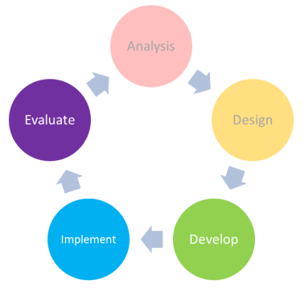
PROPOSED TASK SCHEDULE
Week | Activities
1 | Project Kick-Off Meeting Project Manager creates project plan
1 - 18 | Project Manager: Coordinates all activities of Instructional Designer, Course Developer, and vendors Contacts copyright holders to obtain e-print & derivative permissions to source content Contracts and works with vendors to create derivative material Pays all invoices Contacts Moodle Partners for pricing information
1 - 16 | Instructional Designer completes Storyboard including graphics
16 - 17 | Course Developer populates Moodle Classroom
18 | Instructional Designer tests course functionality
Identification
Purpose
Status
Resources
Schedule
Challenges
Recommendations
Summary

Slide 10
Challenges [1 of 3]
Resource Allocation
AMCC requires approval from Food Business 101
If approved, Food Business 101 and AMCC will create/sign a Statement of Work in the amount of $32,392
If approval is not obtained:
AMCC will turn over materials created to date to Food Business 101
No further action will be taken by the AMCC team
Identification
Purpose
Status
Resources
Schedule
Challenges
Recommendations
Summary

Slide 11
Challenges [2 of 3]
Subject Matter Availability
Subject Matter Expert has competing priorities and will unavailable for 4 weeks during the completion of course development
Unless another Subject Matter Expert is assigned, AMCC will be unable to progress with the project
Identification
Purpose
Status
Resources
Schedule
Challenges
Recommendations
Summary

Slide 12
Challenges [3 of 3]
Course Environment
Free Moodle Classroom will work for the pilot
However, with a limitation of only 50 users maximum and 200Mb disk space, this is not a sustainable solution for the future
https://moodle.com/cloud/
Identification
Purpose
Status
Resources
Schedule
Challenges
Recommendations
Summary

Slide 13
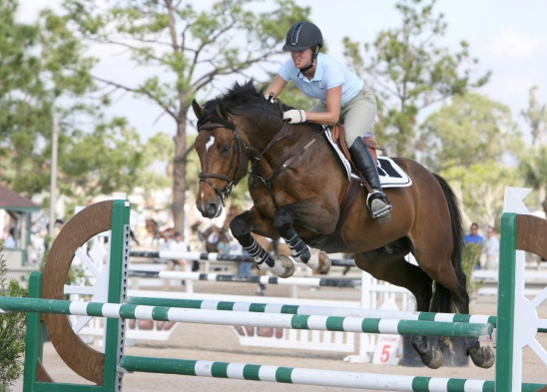
Recommendations [1 of 2]
Resource Allocation
AMCC recommends the approval the additional resource allocation
This recommendation supports the mission of Food Business 101
Subject Matter Availability
If a replacement is found, the 18 week timeline can stand
Otherwise, an additional 4 weeks will be needed
Identification
Purpose
Status
Resources
Schedule
Challenges
Recommendations
Summary

Slide 14
Recommendations [2 of 2]
Course Environment
Use the free class room environment for the pilot
To ensure the viability of the project
AMCC will investigate Moodle Partners for hosting options and provide a separate recommendation
Identification
Purpose
Status
Resources
Schedule
Challenges
Recommendations
Summary

Slide 15
summary
In keeping with Food Business 101 mandates, it is recommended that the resource allocation be approved
18 weeks are needed to complete course development/testing
22 weeks are needed, if an additional subject matter expert is not available
The Moodle Cloud free environment is recommended for the pilot
To ensure course viability
Identification
Purpose
Status
Resources
Schedule
Challenges
Recommendations
Summary

Slide 16
REFERENCES
Images shown in order of appearance
L, H. (n.d.). Blue pass 2 [Digital Image]. Retrieved from http://www.freeimages.com/photo/blue-pass-2-1196199
Michelini, M. (2003). Compass [Digital Image]. Retrieved from http://www.freeimages.com/photo/compass-1422822
Ziga. (2000). Navigation [Digital Image]. Retrieved from http://www.freeimages.com/photo/navigation-1459802

Slide 17
REFERENCES
Images shown in order of appearance [Continued]
Cornejo, S. (2002). Legos people group [Digital Image]. Retrieved from http://www.freeimages.com/photo/legos-people-group-1240136
Hol, M. (2004). Fence 1 [Digital Image]. Retrieved from http://www.freeimages.com/photo/fence-1-1496842
Borysewicz, J. (2006). Team work [Digital Image]. Retrieved from http://www.freeimages.com/photo/team-work-1515347

Slide 18
REFERENCES
Images shown in order of appearance [Continued]
Simon, S. (2001). End of holidays [Digital Image]. Retrieved from http://www.freeimages.com/photo/end-of-holidays-1504858

