Slide 1
Storyboard
Course: Action Planning for the 12 Dimensions of Your Successful Food Service Business
BY Joanne Deitsch
DETT 607 Section 9040 Assignment 4: COUrse storyboard 22-November-2015

Slide 2
Storyboard topics
Purpose
Course Basics
Overview
Audience
Learning Objectives
Course Topics
Course Environment
Interaction
Gagné's Events of Instruction
Course Overview
Course Sample

Slide 3
Purpose
Food Business 101 approved the learning design created by A Mythical Consulting Company (AMCC) for the course Action Planning for the 12 Dimensions of Your Successful Food Service Business
Food Business 101 asked AMCC to create a Storyboard as a proof of concept for this project

Slide 4
Couse Basics
Overview
The course aims to orient restaurateurs to the realities and dimensions of a start-up operation
14 week online course
Two weeks for welcome and wrap up
12 topics are discussed, one for each of the remaining 12 weeks

Slide 5
Couse Basics
Audience
Typical learner is 25 to 35 years old
The vocabulary and language used in the course are no higher than a high school level to accommodate the various academic achievement levels of the learners

Slide 6
Couse Basics
Learning Objectives
Identify all 12 dimensions of any food business in accordance with the course materials.
Based on current literature, describe the top three characteristics of each dimension.
Create an action plan that contextually applies each dimension to either an existing or prospective food business.

Slide 7
Couse Basics
Course Topics in Week Order
Welcome
Leadership Team
Team Dynamics
Management
Staff
Systems
Financing/Cash Flow
Marketing
Menu
Communications
Equipment/Textiles
Technology
Planning
Wrap Up

Slide 8
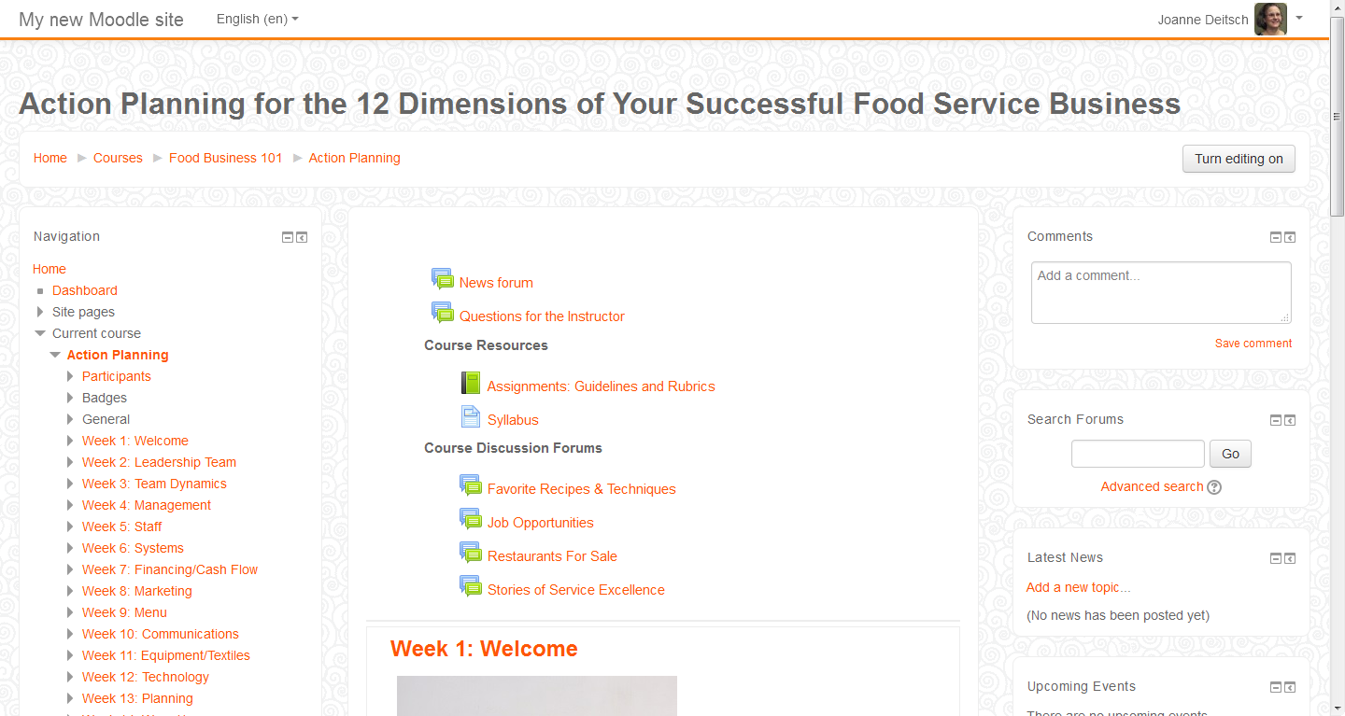
Course Environment
Moodle Cloud
Breadcrumbs
Available the Entire Course:
Course Resources
Course Discussion Forums
Navigation Bar
Topic Content

Slide 9
Interaction
Learner - Content
Moodle cloud provides a classroom portal for learners to interact with the course content and submit assignments
Learners will also obtain sources via the internet when completing assignments as shown below:
Assignment | Assessment Type | Percentage of Total | Internet Sources?
Discussion Forum Participation | Formative Assessment | 15% | Yes
Learning Journal | Formative Assessment | 20% | No
Make Your Case Essays | Formative Assessment | 30% | Yes
Topic Tests | Formative Assessment | 10% | No
Action Plan | Summative Assessment | 25% | Yes

Slide 10
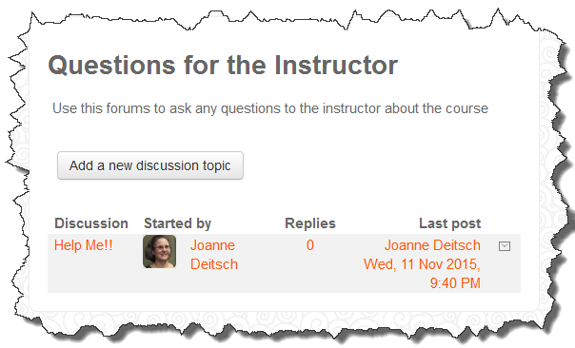
Interaction
Learner - Instructor
Questions for the Instructor Discussion Forum
Via Moodle Classroom
Virtual Office Hours
1 hour each Tuesday & Friday
Via Adobe Connect Meeting
Email
Posted in Moodle Classroom

Slide 11
Interaction
Learner – Instructor [Continued]
Topic Discussion Forum
Via Moodle Classroom
Instructor responds to each original post
To seek clarification, where needed
To deepen and expand the conversation

Slide 12
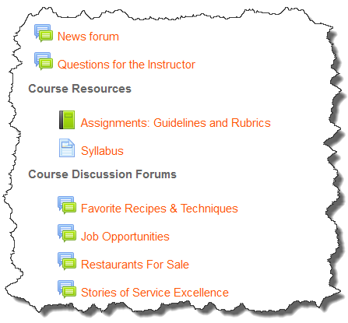
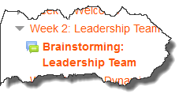
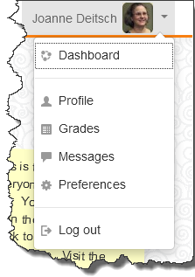
Interaction
Learner - Learner
Non-content related Discussion Forums
Via Moodle Classroom
Topic Discussion Forums
Via Moodle Classroom
Messaging
Via Moodle Classroom

Slide 13
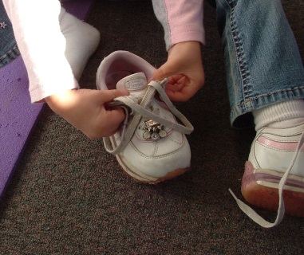
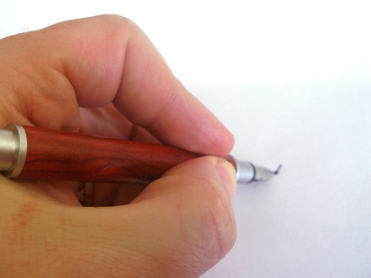
Stimulus
GAGNÉ’S EVENTS OF INSTRUCTION

Slide 14
GAGNÉ’S events of instruction
Overview
Gagné’s Events of Instruction were used to develop this storyboard:
Harasim, L. (2011). Learning theory and online technologies. Routledge, Taylor & Francis Group.
# | Event |  | # | Event
1 | Gaining Attention |  | 6 | Eliciting Performance
2 | Informing Learner of Objective |  | 7 | Providing Feedback
3 | Stimulating Recall |  | 8 | Assessing Performance
4 | Presenting the Stimulus |  | 9 | Enhancing Retention and Transfer
5 | Providing Learning Guidance

Slide 15
Course overview
Summary
The following slides summarize how each element of the course corresponds to Gagné’s Events of Instruction

Slide 16
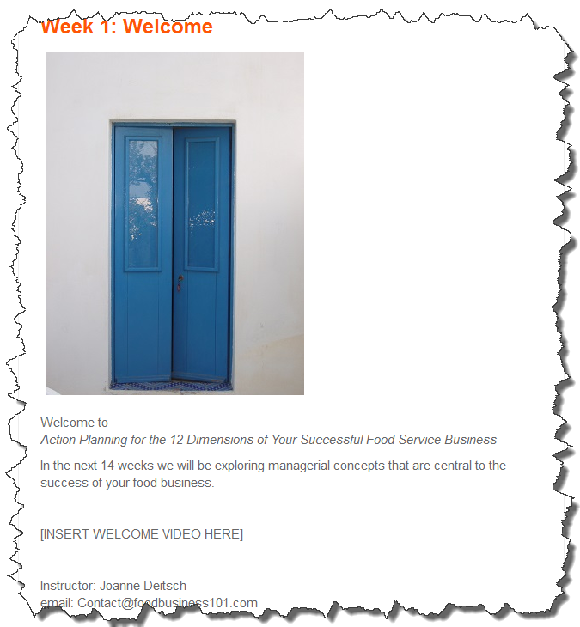
Course overview
Event 1: Gaining Attention (Gagné)
Text and video greeting on the topic home page that appears on the course home page

Slide 17
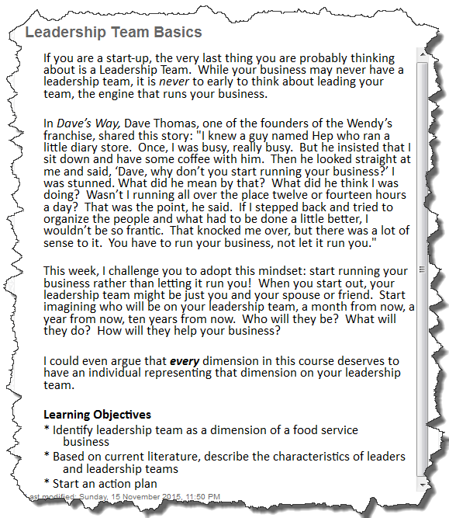
Course overview
Event 2: Informing Learner of Objective (Gagné)
Text Topic Basics Page
Introduces the topic
Lists the associated learning objectives

Slide 18
Course overview
Event 3: Stimulating Recall of Previous Learning (Gagné)
Topic Pre-Assessment
5-10 question quiz
Brainstorming Discussion
Provides an opportunity for learners to recall and share their prior experience and knowledge
Submission Details: Topic Discussion Forum via Moodle Classroom
Assignment Details: Posted in the Assignments ebook in the Moodle Classroom and appear below
Discussion Forum Guidelines
Discussion Forum Rubric

Slide 19
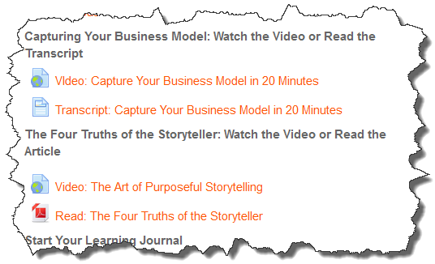
Course overview
Stimulus
Event 4: Presenting the Stimulus (Gagné)
Topic related content is presented
Reflection questions presented to set the stage for reading
Content presented in two different formats
Text and Video
Text and Podcast

Slide 20
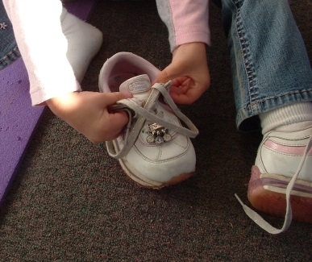
Course overview
Event 5: Providing Learning Guidance (Gagné)
Learning guidance for the entire course are elaborated in the attached Syllabus
Learning guidance provided in guidance documents
Action Plan Guidelines
Learning Journal Guidelines
Make Your Case Guidelines
Discussion Forum Guidelines
Learning guidance provide via interactions
As described in the Interactions section

Slide 21
Course overview
Event 6: Eliciting Performance (Gagné)
Topic Reflections Discussion
Provides an opportunity to reflect on the reading, video or podcast content for the topic
Submission Details: Topic Discussion Forum via Moodle Classroom
Assignment Details: Posted in the Assignments ebook in the Moodle Classroom and appear below
Discussion Forum Guidelines
Discussion Forum Rubric

Slide 22
Course overview
Event 6: Eliciting Performance (Gagné) [Continued]
Topic Actions Discussion
Provides an opportunity to prepare and receive feedback on draft thoughts on that topic’s portion of the action plan
Submission Details: Topic Discussion Forum via Moodle Classroom
Assignment Details: Posted in the Assignments ebook in the Moodle Classroom and appear below
Discussion Forum Guidelines
Discussion Forum Rubric

Slide 23
Course overview
Event 6: Eliciting Performance (Gagné) [Continued]
Learning Journal
Provides an opportunity to create a reflective learning journal and notebook on course content
Submission Details: Topic Assignment Module via Moodle Classroom
Assignment Details: Posted in the Assignments ebook in the Moodle Classroom and given below
Learning Journal Guidelines
Learning Journal Rubric

Slide 24
Course overview
Event 6: Eliciting Performance (Gagné) [Continued]
Make Your Case Essays
Provides an opportunity to write persuasive essays on critical business topics
Submission Details: Topic Assignment Module via Moodle Classroom
Assignment Details: Posted in the Assignments ebook in the Moodle Classroom and appear below
Make Your Case Guidelines
Make Your Case Rubric
Topic Assessment
5-10 question quiz

Slide 25
Course overview
Event 6: Eliciting Performance (Gagné) [Continued]
Action Plan
Provides an opportunity to create an action plan for a prospective or existing food business
Submission Details: Topic Assignment Module via Moodle Classroom
Assignment Details: Posted in the Assignments ebook in the Moodle Classroom and appear below
Action Plan Guidelines
Action Plan Rubric

Slide 26
Course overview
Event 7: Providing Feedback (Gagné)
Topic Reflections Discussion
Topic Discussion Forum via Moodle Classroom
Respond to learner’s posts as outlined in the Interaction section
Topic Action Discussion
Topic Discussion Forum via Moodle Classroom
Respond to learner’s posts as outlined in the Interaction section
Topic Assessment
Answers to 5-10 question quiz

Slide 27
Course overview
Event 8: Assessing Performance (Gagné)
Discussion Forum Participation
Provide assessment results as outlined in the Discussion Forum Rubric
Learning Journal Participation
Provide assessment results as outlined in the Learning Journal Rubric
Make Your Cases Essays
Provide assessment results as outlined in the Make Your Case Rubric
Topic Assessment [a.k.a. Topic Test]
Points assigned to responses to 5-10 question quiz
Grades are automatically posted in the Moodle Classroom
Action Plan
Provide feedback as outlined in the Action Plan Rubric

Slide 28
Course overview
Event 9: Enhancing Retention and Transfer (Gagné)
Learning Journal
Details given below are posted in the Assignments ebook in the Moodle Classroom
Learning Journal Guidelines
Learning Journal Rubric

Slide 29
Stimulus
COURSE SAMPLE

Slide 30
Course sample
Four topics complete with content and assessments are shown in this sample
Welcome
Topic 1: Leadership Team
Topic 2: Team Dynamics
Wrap Up

Slide 31
Topic: Welcome (Week 1)
Event 1: Gaining Attention (Gagné)
Welcome Message (Delivered in both text and video formats)
Welcome to Action Planning for the 12 Dimensions of Your Successful Food Service Business.
In the next 14 weeks we will be exploring managerial concepts that are central to the success of your food business. We’ll start our journey together this week focusing on business models and storytelling.
What you should do this week:
Review the Course Syllabus
Read or watch Capturing Your Business Model
Read or watch The Four Truths of the Storyteller
Participate in Tell Me How You Got Into the Food Business (Almost)
Participate in Professional Introduction
Start your learning journal
See you in the threads!
Joanne Deitsch | joanne@foodbusiness101.com

Slide 32
Topic: Welcome (Week 1)
Event 2: Informing Learner of Objective (Gagné)
The welcome topic is ungraded and does not pertain to any learning objectives
For future reference, the learning objectives for the entire course are elaborated in the attached Syllabus that learners are asked to read this week

Slide 33
Topic: Welcome (Week 1)
Event 3: Stimulating Recall of Previous Learning (Gagné)
The welcome topic is ungraded and does not engage the learner in graded recall activities

Slide 34
Topic: Welcome (Week 1)
Stimulus
Event 4: Presenting the Stimulus (Gagné)
As your read or watch this week’s materials think about how these concepts can help you describe and promote your own business.
Read or Watch Capture Your Business Model in 20 Minutes
Transcript of the video (to be developed)
https://www.youtube.com/watch?v=7o8uYdUaFR4
Read or Watch The Four Truths of the Storyteller
Read: http://story4good.com/wp-content/uploads/2010/12/The-Four-Truths-of-the-Storyteller.pdf
Watch: https://www.youtube.com/watch?v=8-KtR4vM4eg

Slide 35
Topic: Welcome (Week 1)
Event 5: Providing Learning Guidance (Gagné)
The welcome topic is ungraded and does not require any guidance be given

Slide 36
Topic: Welcome (Week 1)
Event 6: Eliciting Performance (Gagné)
The welcome topic is ungraded and does not pertain to any performance goals
However, there are engagement activities that the learner should complete that are mentioned here
Icebreaker One: Tell Me How You Got Into the Food Business (Almost)
Discussion Forum via Moodle Classroom
Post a short story that tells the who, what, where, and when of how you got started in the food business. In the story, include one false fact. Guess at facts that are not true in your classmate’s stories. Each learner reveals the false fact at the end of week two.

Slide 37
Topic: Welcome (Week 1)
Event 6: Eliciting Performance (Gagné) [Continued]
Icebreaker Two: Professional Introduction
Discussion Forum via Moodle Classroom
Post a professional introduction that tells the class about your background and your current job. Please use at least three to five sentences.

Slide 38
Topic: Welcome (Week 1)
Event 7: Providing Feedback (Gagné)
The welcome topic is ungraded so there is no required feedback

Slide 39
Topic: Welcome (Week 1)
Event 8: Assessing Performance (Gagné)
The welcome topic is ungraded and there is no performance to assess

Slide 40
Topic: Welcome (Week 1)
Event 9: Enhancing Retention and Transfer (Gagné)
The welcome topic is ungraded and there is no performance to assess
However, the learners are asked to start their learning journal this week
Learning Journal
Details given below are posted in the Assignments ebook in the Moodle Classroom
Learning Journal Guidelines
Learning Journal Rubric

Slide 41
Topic: Leadership team (Week 2)
Event 1: Gaining Attention (Gagné)
Welcome Message (Delivered in both text and video formats)
[Debrief for last week’s forum posts will be in the video]
This week we start talking about the first dimension of a successful food business: The Leadership Team.
What you should do this week:
Read Leadership Basics
Pre-Assessment (optional)
If not already done, participate in last week’s discussion forums
Post in the Brainstorming Discussion (Do this first!)
Read or listen to The Leadership Team
Read or listen to Top 10 Qualities That Make A Great Leader
Post in Your Leadership Team Discussions
Start your action plan
Remember to post in your Learning Journal
See you in the threads!
Joanne Deitsch | joanne@foodbusiness101.com

Slide 42
Topic: Leadership team (Week 2)
Event 2: Informing Learner of Objective (Gagné)
Leadership Basics
If you are a start-up, the very last thing you are probably thinking about is a Leadership Team. While your business may never have a leadership team, it is never to early to think about leading your team, the engine that runs your business.
In Dave’s Way, Dave Thomas, one of the founders of the Wendy’s franchise, shared this story: “I knew a guy named Hep who ran a little diary store. Once, I was busy, really busy. But he insisted that I sit down and have some coffee with him. Then he looked straight at me and said, ‘Dave, why don’t you start running your business?’ I was stunned. What did he mean by that? What did he think I was doing? Wasn’t I running all over the place twelve or fourteen hours a day? That was the point, he said. If I stepped back and tried to organize the people and what had to be done a little better, I wouldn’t be so frantic. That knocked me over, but there was a lot of sense to it. You have to run your business, not let it run you.“

Slide 43
Topic: Leadership team (Week 2)
Event 2: Informing Learner of Objective (Gagné) [Cont’d]
This week, I challenge you to adopt this mindset: start running your business rather than letting it run you! When you start out, your leadership team might be just you and your spouse or friend. Start imagining who will be on your leadership team, a month from now, a year from now, ten years from now. Who will they be? What will they do? How will they help your business?
I could even argue that every dimension in this course deserves to have an individual representing that dimension on your leadership team.
Learning Objectives
Identify leadership team as a dimension of a food service business
Based on current literature, describe the characteristics of leaders and leadership teams
Start an action plan

Slide 44
Topic: Leadership team (Week 2)
Event 3: Stimulating Recall of Previous Learning (Gagné)
Leadership Team Pre-Assessment
If learner earns 100%, they can skip this weeks reading
Correct answers are bolded
Question: What are the symptoms that a leadership team is in peril?
Answers: a) disagreement on priorities, b) difficult transition of new team members, c) lack of explicit agreement of responsibilities among team members, d) all of the above
Question: Which is NOT a leadership characteristic?
Answers: a) honesty, b) inability to delegate, c) communication
, d) all of the above
Question: True/False: For large organizations, multiple leaders with different skills are needed to run the business
Answers: True

Slide 45
Topic: Leadership team (Week 2)
Event 3: Stimulating Recall [Continued]
Question: What does NOT signal leadership alignment?
Answers: a) lack of common vision, b) rewards for achieving common goals, c) constant communication, d) trust that all team members have the organization’s best interests at heart

Slide 46
Topic: Leadership team (Week 2)
Event 3: Stimulating Recall [Continued]
Brainstorming Discussion
Topic Discussion Forum via Moodle Classroom
Details given below are posted in the Assignments ebook in the Moodle Classroom
Discussion Forum Guidelines
Discussion Forum Rubric
Share with the class your experiences leading other people. What was the situation? What did you do? If you are comfortable sharing, did get any feedback for those you led and what was it?
Before you say, “I’ve never lead a team!” remember those times you led a sports or professional association team OR lead a group project at school

Slide 47
Topic: Leadership team (Week 2)
Stimulus
Event 4: Presenting the Stimulus (Gagné)
When reading this week’s selections, think about your own business or job. Who serves on your leadership team? How do you know they are great leaders? How does this week’s reading bear on your own business?
Read or listen to The Leadership Team
http://mg.dsub.net/sites/default/files/press/hbr_article_leadership_team.pdf
Podcast TBD
Read of listen to Top 10 Qualities That Make A Great Leader
http://www.forbes.com/sites/tanyaprive/2012/12/19/top-10-qualities-that-make-a-great-leader/
Podcast TBD

Slide 48
Topic: Leadership team (Week 2)
Event 5: Providing Learning Guidance (Gagné)
Learning guidance for the entire course are elaborated in the attached Syllabus
Learning guidance provided in guidance documents
As described throughout this topic
Learning guidance provide via interactions
As described in the Interactions section

Slide 49
Topic: Leadership team (Week 2)
Event 6: Eliciting Performance (Gagné) [Continued]
Leadership Team Reflections Discussion
Topic Discussion Forum via Moodle Classroom
Details given below are posted in the Assignments ebook in the Moodle Classroom
Discussion Forum Guidelines
Discussion Forum Rubric
Share with the class a story on one of the topics shown below:
Someone you worked with that displays one of the 10 qualities mentioned in this week’s reading
How leaders you have worked with having differing agendas and the situations that caused

Slide 50
Topic: Leadership team (Week 2)
Event 6: Eliciting Performance (Gagné) [Continued]
Leadership Team Action Discussion
Topic Discussion Forum via Moodle Classroom
Details given below are posted in the Assignments ebook in the Moodle Classroom
Discussion Forum Guidelines
Discussion Forum Rubric
Share with the class details about your current leadership team or how you imagine your leadership team will look like 5 years for now. Who will be on the team? What will they do? To get ideas about who should be on your future team and how they should interact, be sure to run an internet search on large scale franchises that serve the same food you serve or envision serving
Remember to save your response in your draft action plan

Slide 51
Topic: Leadership team (Week 2)
Event 7: Providing Feedback (Gagné)
Leadership Team Reflections Discussion
Topic Discussion Forum via Moodle Classroom
Respond to learner’s posts as outlined in the Interaction section
Leadership Team Action Discussion
Topic Discussion Forum via Moodle Classroom
Respond to learner’s posts as outlined in the Interaction section

Slide 52
Topic: Leadership team (Week 2)
Event 8: Assessing Performance (Gagné)
Topic assessments take place later in the course

Slide 53
Topic: Leadership team (Week 2)
Event 9: Enhancing Retention and Transfer (Gagné)
Learning Journal
Details given below are posted in the Assignments ebook in the Moodle Classroom
Learning Journal Guidelines
Learning Journal Rubric

Slide 54
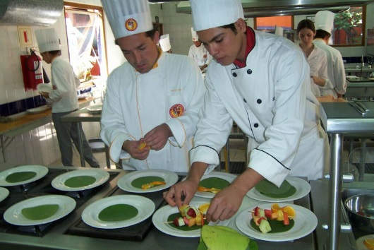
Topic: Team Dynamics (Week 3)
Event 1: Gaining Attention (Gagné)
Welcome Message (Delivered in both text and video formats)
[Debrief for last week’s forum posts will be in the video]
This week we continue our journey by visiting the team dynamics dimension of a successful food business.
What you should do this week:
Read Team Dynamics Basics
Pre-Assessment (optional)
If not already done, participate in last week’s discussion forums
Post in the Brainstorming Discussion (Do this first!)
Read or listen to Build A High-Performing Team In 30 Minutes
Read or listen to A Business Case for Optimal Motivation
Post in the Team Dynamics Discussions
Complete Leadership Team Assessment
Continue your action plan
Remember to post in your Learning Journal
See you in the threads!
Joanne Deitsch | joanne@foodbusiness101.com

Slide 55
Topic: Team Dynamics (Week 3)
Event 2: Informing Learner of Objective (Gagné)
Team Dynamics Basics
Leaders lead teams. If you don’t like working with teams, the food business is not for you.
In Rich Dad’s Guide to Investing, Robert Kiyosaki, gives his insight about the importance of teams: “For people considering building a powerful and successful business, I think this lesson of teamwork is crucial. It is one of the primary keys to my financial success. Business and investing are team sports, and remember that every day in business is test time. To be successful in school, you had to take tests alone. In business, success comes from taking tests as a team, not as an individual.”

Slide 56
Topic: Team Dynamics (Week 3)
Event 2: Informing Learner of Objective (Gagné) [Cont’d]
This week, I challenge you to focus on your team. As a leader, how can you become a better team member? What do you expect from your team? Are your expectations realistic? How well do you communicate with other team members? If you currently lead a team, actively solicit your team’s feedback on how you are doing as a team member.
Learning Objectives
Identify team dynamics as a dimension of a food service business
Based on current literature, describe the characteristics of high performing teams
Continue you action plan

Slide 57
Topic: team DYNAMICS (Week 3)
Event 3: Stimulating Recall of Previous Learning (Gagné)
Team Dynamics Pre-Assessment [a.k.a. Topic Test]
If learner earns 100%, they can skip this weeks reading
Correct answers are bolded
Question: Finish the sentence: Which is NOT an element displayed by teams:
Answers: a) common commitment and purpose, b) autonomy, c) complementary skills, d) mutual accountability
Question: Who creates team operating principles?
Answers: a) the business owner, b) the team leader, c) the entire team,
d) the general manager
Question: When establishing team operating principles, what are the parts of the initial meeting?
Answers: a) make it an uninterrupted time b) provide examples before the meeting, c) have team members develop principles before the meeting, d) all of the above

Slide 58
Topic: Team Dynamics (Week 3)
Event 3: Stimulating Recall [Continued]
Question: What is the leader’s role during the initial meeting to establishing team operating principles?
Answers: a) direct the meeting, b) facilitate the conversation, c) participate in the meeting, d) none of the above
Question: Which workplace beliefs erode workplace motivation?
Answers: a) it’s not personal; it’s just business, b) the purpose of business is to make money, c) leaders are in a position of power, d) all of the above
Question: What must leaders do to help team members be more motivated?
Answers: a) issue directives, b) encourage autonomy, c) develop competence, d) connect to purpose
Question: Put the three steps to changing motivational outlook in the proper order: x = shift or maintain outlook, y = identify outlook, z = reflect on feelings
Answers: a) x first, y second, z last, b) z first, y second, x last, c) y first, x second, z last, d) z first, x second, y last

Slide 59
Topic: Team Dynamics (Week 3)
Event 3: Stimulating Recall [Continued]
Question: True or False: Leaders are great at motivating other people
Answers: False

Slide 60
Topic: Team Dynamics (Week 3)
Event 3: Stimulating Recall [Continued]
Brainstorming Discussion
Topic Discussion Forum via Moodle Classroom
Details given below are posted in the Assignments ebook in the Moodle Classroom
Discussion Forum Guidelines
Discussion Forum Rubric
Share with the class your experiences working as part of a team. What was the situation? What did you do? If you are comfortable sharing, did get any feedback for your team members and what was it?
Before you say, “I’ve never been part of a team!” remember those times you were a member of a sports or professional association team OR worked as part of a team on a group project at school

Slide 61
Topic: Team Dynamics (Week 3)
Stimulus
Event 4: Presenting the Stimulus (Gagné)
When reading this week’s selections, think about your own business or job. Who are your team members? What makes a great team member? How does this week’s reading bear on your own business?
Read or listen to Build A High-Performing Team In 30 Minutes
http://www.forbes.com/sites/work-in-progress/2014/09/10/build-a-high-performing-team-in-30-minutes/
Podcast TBD
Read or listen to A Business Case for Optimal Motivation
http://www.kenblanchard.com/getattachment/Leading-Research/Research/A-Business-Case-for-Optimal-Motivation/Optimal-Motvation-white-paper-MK0800-2.pdf
Podcast TBD

Slide 62
Topic: Team Dynamics (Week 3)
Event 5: Providing Learning Guidance (Gagné)
Learning guidance for the entire course are elaborated in the attached Syllabus
Learning guidance provided in guidance documents
As described throughout this topic
Learning guidance provide via interactions
As described in the Interactions section

Slide 63
Topic: Team Dynamics (Week 3)
Event 6: Eliciting Performance (Gagné)
Team Dynamics Reflections Discussion
Topic Discussion Forum via Moodle Classroom
Details given below are posted in the Assignments ebook in the Moodle Classroom
Discussion Forum Guidelines
Discussion Forum Rubric
Share with the class a story on one of the topics shown below:
Someone you worked with that displays one of the qualities mentioned in this week’s reading
Share a story about the best team you ever worked with. What made that team great? Describe the contributions that you and other team members made. How did you feel? What was the result? How does this story relate to this week’s reading?

Slide 64
Topic: Team Dynamics (Week 3)
Event 6: Eliciting Performance (Gagné) [Continued]
Team Dynamics Action Discussion
Topic Discussion Forum via Moodle Classroom
Details given below are posted in the Assignments ebook in the Moodle Classroom
Discussion Forum Guidelines
Discussion Forum Rubric
Share with the class details about who will be on your business team and your expectations for what they will do. How do you plan to help them become high performing teams? What type of culture do you envision? To get ideas about who should be on your future team members and differing cultures, be sure to run an internet search on large scale franchises that serve the same food you serve or envision serving
Remember to save your response in your draft action plan

Slide 65
Topic: Team Dynamics (Week 3)
Event 7: Providing Feedback (Gagné)
Team Dynamics Reflections Discussion
Topic Discussion Forum via Moodle Classroom
Respond to learner’s posts as outlined in the Interaction section
Team Dynamics Action Discussion
Topic Discussion Forum via Moodle Classroom
Respond to learner’s posts as outlined in the Interaction section

Slide 66
Topic: Team Dynamics (Week 3)
Event 8: Assessing Performance (Gagné)
The Leadership Team Pre-Assessment [a.k.a. Topic Test] is repeated
Accommodates learners who did not take or failed the pre-assessment
The questions are presented in a different order than the pre-assessment
Grades are automatically posted in the Moodle Classroom

Slide 67
Topic: Team Dynamics (Week 3)
Event 9: Enhancing Retention and Transfer (Gagné)
Learning Journal
Details given below are posted in the Assignments ebook in the Moodle Classroom
Learning Journal Guidelines
Learning Journal Rubric

Slide 68
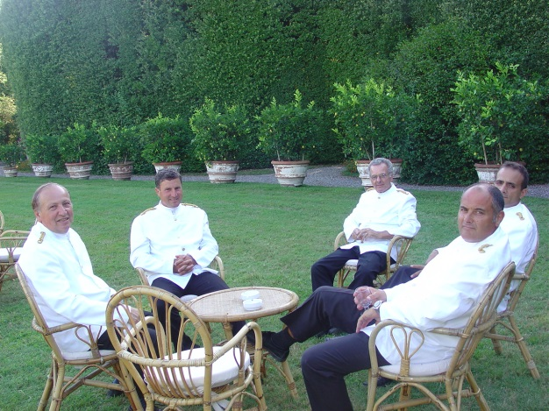
Topic: wrap up (Week 14)
Event 1: Gaining Attention (Gagné)
Farewell Message (Delivered in both text and video formats)
[Discussion forum debrief for the previous week will be in the video only]
Thank you for taking the journey Action Planning for the 12 Dimensions of Your Successful Food Service Business.
It’s been an action-packed 14 weeks exploration of managerial concepts that are central to the success of your food business. We’ll finish our journey together talking about elevator speeches.
What you should do this week:
Take the quiz on last week’s topic
Read and watch 6 Tips for Perfecting Your Elevator Pitch
Post your elevator speech and give feedback on your classmate’s posts
Review the Food Business 101 Community page
What you should expect by the end of this week:
Grade/feedback on your action plan
You r final grade/badge via email
If you want to keep in touch with your classmates, post your social media information in the Keep in Touch discussion forum in this week’s topic.
Thank you for taking this journey!
Joanne Deitsch | joanne@foodbusiness101.com

Slide 69
Topic: Wrap up (Week 14)
Event 2: Informing Learner of Objective (Gagné)
The wrap up topic is ungraded and does not pertain to any learning objectives

Slide 70
Topic: Wrap up (Week 14)
Event 3: Stimulating Recall of Previous Learning (Gagné)
This is the wrap up week ending the course
All recall strategies have already been applied

Slide 71
Topic: Wrap up (Week 14)
Stimulus
Event 4: Presenting the Stimulus (Gagné)
Read and Watch 6 Tips for Perfecting Your Elevator Pitch
http://www.entrepreneur.com/article/228070

Slide 72
Topic: Wrap up (Week 14)
Event 5: Providing Learning Guidance (Gagné)
This is the wrap up week ending the course
All learning guidance has already been provided

Slide 73
Topic: Wrap up (Week 14)
Event 6: Eliciting Performance (Gagné)
Write Elevator Speech
Discussion Forum via Moodle Classroom
Post your elevator speech and give feedback on your classmates’ posts.

Slide 74
Topic: Wrap up (Week 14)
Event 7: Providing Feedback (Gagné)
Write Elevator Speech Discussion Forum
Post feedback in the threads

Slide 75
Topic: Wrap up (Week 14)
Event 8: Assessing Performance (Gagné)
The Planning Pre-Assessment [Topic Test] is repeated
Accommodates learners who did not take or failed the pre-assessment
The questions are presented in a different order than the pre-assessment
Grades are automatically posted in the Moodle Classroom

Slide 76
Topic: Wrap up (Week 14)
Event 8: Assessing Performance (Gagné) [Continued]
Assess learner’s final discussion forums
Award points based on the Discussion Forum Rubric
Post grade in Moodle classroom
Assess learner’s final learning journal
Award points based on the Learning Journal Rubric
Post grade in Moodle classroom

Slide 77
Topic: Wrap up (Week 14)
Event 8: Assessing Performance (Gagné) [Continued]
Assess learner’s action plans
Award points based on the Action Plan Rubric
Post grade in Moodle classroom
Final grades
Post final grades in Moodle classroom
Email final grade/badge via email

Slide 78
Topic: Wrap up (Week 14)
Event 9: Enhancing Retention and Transfer (Gagné)
This is the wrap up week ending the course
All retention and transfer strategies have already been applied

