Slide 1
Storyboard
Course: Action Planning for the 12 Dimensions of Your Successful Food Service Business
BY Joanne Deitsch
DETT 607 Section 9040 Assignment 3: PEER REVIEW 13-November-2015

Slide 2
Storyboard topics
Course Basics
Course Environment
Interaction
Events of Instruction
For each topic using Gagné's 9 events of instruction

Slide 3
Couse Basics [1 of 3]
Overview
The course aims to orient restaurateurs to the realities and dimensions of a start-up operation
14 week online course
Two weeks for welcome and wrap up
12 topics are discussed, one for each of the remaining 12 weeks

Slide 4
Couse Basics [2 of 3]
Audience
Typical learner is 25 to 35 years old
The vocabulary and language used in the course are no higher than a high school level to accommodate the various academic achievement levels of the learners

Slide 5
Couse Basics [3 of 3]
Learning Objectives
Identify all 12 dimensions of any food business in accordance with the course materials.
Based on current literature, describe the top three characteristics of each dimension.
Create an action plan that contextually applies each dimension to either an existing or prospective food business.

Slide 6
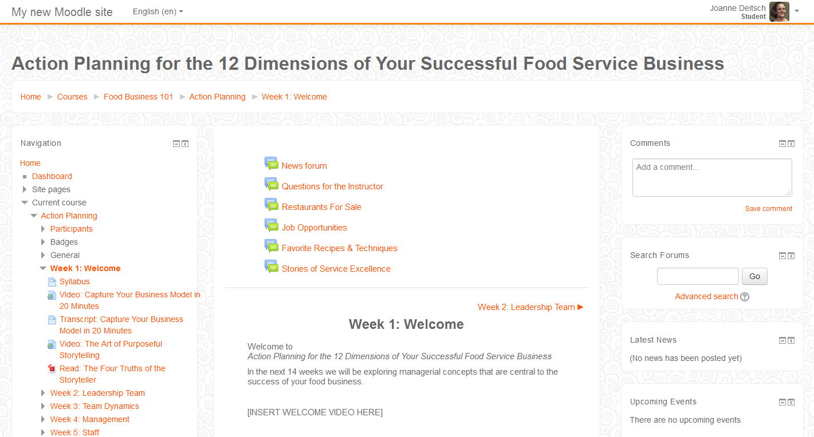
Course Environment
Available the Entire Course:
News & Discussion Forums
Moodle Cloud
Navigation with Breadcrumbs
Navigation Bar
Topic Content

Slide 7
Interaction [1 of 3]
Learner - Content
Moodle cloud provides a classroom portal for learners to interact with the course content and submit assignments
Learners will also obtain sources via the internet when completing assignments as shown below:
Assignment | Assessment Type | Percentage of Total | Internet Sources?
Discussion Forum Participation | Formative Assessment | 15% | Yes
Learning Journal | Formative Assessment | 20% | No
Make Your Case Essays | Formative Assessment | 30% | Yes
Topic Tests | Formative Assessment | 10% | No
Action Plan | Summative Assessment | 25% | Yes

Slide 8
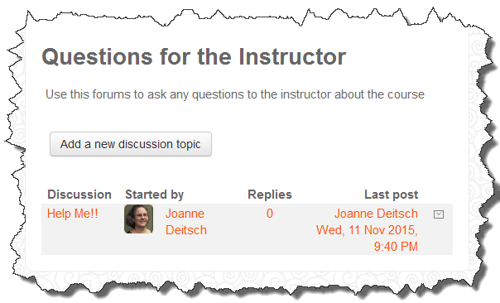
Interaction [2 of 3]
Learner - Instructor
Questions for the Instructor Discussion Forum
Via Moodle Classroom
Virtual Office Hours
1 hour each Tuesday & Friday
Via Adobe Connect Meeting
Email
Posted in Moodle Classroom

Slide 9
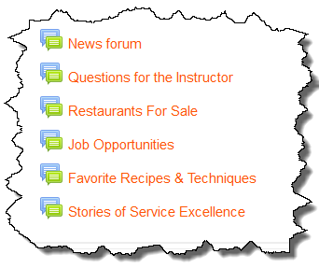
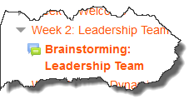
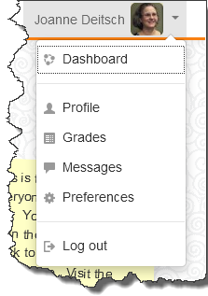
Interaction [3 of 3]
Learner - Learner
Non-content related Discussion Forums
Via Moodle Classroom
Topic Discussion Forums
Via Moodle Classroom
Messaging
Via Moodle Classroom

Slide 10
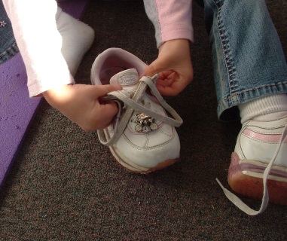
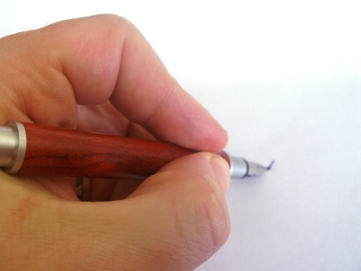
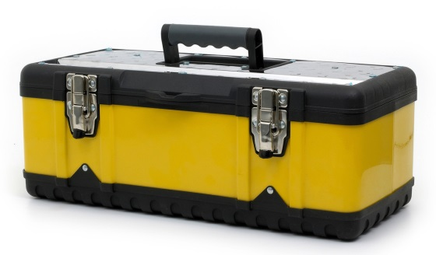
Stimulus
GAGNÉ’S EVENTS OF INSTRUCTION

Slide 11
Topic: Welcome (Week 1)
Event 1: Gaining Attention (Gagné)
Welcome Message (Delivered in both text and video formats)
Welcome to Action Planning for the 12 Dimensions of Your Successful Food Service Business.
In the next 14 weeks we will be exploring managerial concepts that are central to the success of your food business. We’ll start our journey together this week focusing on business models and storytelling.
What you should do this week:
Review the Course Syllabus
Read or watch Capturing Your Business Model
Read or watch The Four Truths of the Storyteller
Participate in Tell Me How You Got Into the Food Business (Almost)
Participate in Professional Introduction
Start your learning journal
See you in the threads!
Joanne Deitsch | joanne@foodbusiness101.com

Slide 12
Topic: Welcome (Week 1)
Event 2: Informing Learner of Objective (Gagné)
The welcome topic is ungraded and does not pertain to any learning objectives
For future reference, the learning objectives for the entire course are elaborated in the attached Syllabus that learners are asked to read this week

Slide 13
Topic: Welcome (Week 1)
Event 3: Stimulating Recall of Previous Learning (Gagné)
The welcome topic is ungraded and does not engage the learner in recall activities

Slide 14
Topic: Welcome (Week 1)
Stimulus
Event 4: Presenting the Stimulus (Gagné)
Read or Watch Capture Your Business Model in 20 Minutes
Transcript of the video (to be developed)
https://www.youtube.com/watch?v=7o8uYdUaFR4
Read or Watch The Four Truths of the Storyteller
Read: http://story4good.com/wp-content/uploads/2010/12/The-Four-Truths-of-the-Storyteller.pdf
Watch: https://www.youtube.com/watch?v=8-KtR4vM4eg

Slide 15
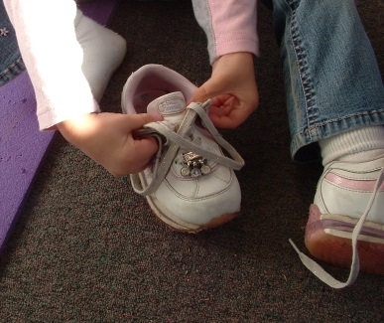
Topic: Welcome (Week 1)
Event 5: Providing Learning Guidance (Gagné)
The welcome topic is ungraded and does not require any guidance be given
For future reference, the learning guidance for the entire course are elaborated in the attached Syllabus that learners are asked to read this week

Slide 16
Topic: Welcome (Week 1)
Event 6: Eliciting Performance (Gagné)
The welcome topic is ungraded and does not pertain to any performance goals
However, there are engagement activities that the learner should complete that are mentioned here
Icebreaker One: Tell Me How You Got Into the Food Business (Almost)
Discussion Forum via Moodle Classroom
Post a short story that tells the who, what, where, and when of how you got started in the food business. In the story, include one false fact. Guess at facts that are not true in your classmate’s stories. Each learner reveals the false fact at the end of week two.

Slide 17
Topic: Welcome (Week 1)
Event 6: Eliciting Performance (Gagné) [Continued]
Icebreaker Two: Professional Introduction
Discussion Forum via Moodle Classroom
Post a professional introduction that tells the class about your background and your current job. Please use at least three to five sentences.

Slide 18
Topic: Welcome (Week 1)
Event 7: Providing Feedback (Gagné)
The welcome topic is ungraded so there is no required feedback

Slide 19
Topic: Welcome (Week 1)
Event 8: Assessing Performance (Gagné)
The welcome topic is ungraded and there is no performance to assess

Slide 20
Topic: Welcome (Week 1)
Event 9: Enhancing Retention and Transfer (Gagné)
The welcome topic is ungraded and there is no performance to assess
However, the learners are asked to start their learning journal this week
Learning Journal
Posted in the New Forum of the Moodle Classroom
Learning Journal Instructions
Learning Journal Template

Slide 21
Topic: Leadership team (Week 2)
Event 1: Gaining Attention (Gagné)
Welcome Message (Delivered in both text and video formats)
[Debrief for last week’s forum posts will be in the video]
This week we start talking about the first dimension of a successful food business: The Leadership Team.
What you should do this week:
Read Leadership Basics
Pre-Assessment (optional)
If not already done, participate in last week’s discussion forums
Post in the Brainstorming Discussion (Do this first!)
Read The Leadership Team
Read Top 10 Qualities That Make A Great Leader
Post in Your Leadership Team Discussion
Start your action plan
See you in the threads!
Joanne Deitsch | joanne@foodbusiness101.com

Slide 22
Topic: Leadership team (Week 2)
Event 2: Informing Learner of Objective (Gagné)
Leadership Basics
If you are a start-up, the very last thing you are probably thinking about is a Leadership Team. While your business may never have a leadership team, it is never to early to think about leading your team, the engine that runs your business.
In Dave’s Way, Dave Thomas, one of the founders of the Wendy’s franchise, shared this story: “I knew a guy named Hep who ran a little diary store. Once, I was busy, really busy. But he insisted that I sit down and have some coffee with him. Then he looked straight at me and said, ‘Dave, why don’t you start running your business?’ I was stunned. What did he mean by that? What did he think I was doing? Wasn’t I running all over the place twelve or fourteen hours a day? That was the point, he said. If I stepped back and tried to organize the people and what had to be done a little better, I wouldn’t be so frantic. That knocked me over, but there was a lot of sense to it. You have to run your business, not let it run you.“

Slide 23
Topic: Leadership team (Week 2)
Event 2: Informing Learner of Objective (Gagné) [Cont’d]
This week, I challenge you to adopt this mindset: start running your business rather than letting it run you! When you start out, your leadership team might be just you and your spouse or friend. Start imagining who will be on your leadership team, a month from now, a year from now, ten years from now. Who will they be? What will they do? How will they help your business?
I could even argue that every dimension in this course deserves to have an individual representing that dimension on your leadership team.
Learning Objectives
Identify leadership team as a dimension of a food service business
Based on current literature, describe the characteristics of leaders and leadership teams
Start an action plan

Slide 24
Topic: Leadership team (Week 2)
Event 2: Informing Learner of Objective (Gagné) [Cont’d]
Pre-Assessment
If learner earns 100%, they can skip this weeks reading
Correct answers are bolded
Question: Finish the sentence: Ideal leaders …
Answers: a) must be experts on the job of the people they lead, b) are born, not made, c) need time and coaching to develop their skill, d) are well-educated
Question: Which is NOT a leadership characteristic
Answers: a) honesty, b) inability to delegate, c) communication
, d) confident
Question: What do good leaders do all day?
Answers: a) provide structure, b) raise morale, c) strategize about their business, d) build their teams up

Slide 25
Topic: Leadership team (Week 2)
Event 2: Informing Learner of Objective (Gagné) [Cont’d]
Question: How do leaders inspire confidence in those they lead?
Answers: a) share their vision for the business, b) committed to their businesses success, c) are calm, d) all of the above
Question: Why do businesses need leaders?
Answers: a) work hard, b) to provide direction , c) to ensure initiatives are carried out, d) to build morale

Slide 26
Topic: Leadership team (Week 2)
Event 3: Stimulating Recall of Previous Learning (Gagné)
Brainstorming Discussion
Discussion Forum via Moodle Classroom
Share with the class your experiences leading other people. What was the situation? What did you do? If you are comfortable sharing, did get any feedback for those you led and what was it?
Before you say, “I’ve never lead a team!” remember those times you led a sports or professional association team OR lead a group project at school

Slide 27
Topic: Leadership team (Week 2)
Stimulus
Event 4: Presenting the Stimulus (Gagné)
Read The Leadership Team
http://mg.dsub.net/sites/default/files/press/hbr_article_leadership_team.pdf
Read Top 10 Qualities That Make A Great Leader
http://www.forbes.com/sites/tanyaprive/2012/12/19/top-10-qualities-that-make-a-great-leader/

Slide 28
Topic: Leadership team (Week 2)
Event 5: Providing Learning Guidance (Gagné)
Learning guidance for the entire course are elaborated in the attached Syllabus

Slide 29
Topic: Leadership team (Week 2)
Event 6: Eliciting Performance (Gagné)
Leadership Team Discussion
Discussion Forum via Moodle Classroom
Share with the class details about your current leadership team or how you imagine your leadership team will look like 5 years for now. Who will be on the team? What will they do? To get ideas about who should be on your future team and how they should interact, be sure to run an internet search on large scale franchises that serve the same food you do or envision serving

Slide 30
Topic: Leadership team (Week 2)
Event 7: Providing Feedback (Gagné)
Brainstorming Discussion
Discussion Forum via Moodle Classroom
Respond to learner’s posts and comments
Leadership Team Discussion
Discussion Forum via Moodle Classroom
Respond to learner’s posts and comments

Slide 31
Topic: Leadership team (Week 2)
Event 8: Assessing Performance (Gagné)
Formal assessments will take place later in the course

Slide 32
Topic: Leadership team (Week 2)
Event 9: Enhancing Retention and Transfer (Gagné)
Learning Journal
Posted in the New Forum of the Moodle Classroom
Learning Journal Instructions
Learning Journal Template

Slide 33
Topic: planning (Week 13)
Event 1: Gaining Attention (Gagné)

Slide 34
Topic: planning (Week 13)
Event 2: Informing Learner of Objective (Gagné)

Slide 35
Topic: planning (Week 13)
Event 3: Stimulating Recall of Previous Learning (Gagné)

Slide 36
Topic: planning (Week 13)
Stimulus
Event 4: Presenting the Stimulus (Gagné)

Slide 37
Topic: planning (Week 13)
Event 5: Providing Learning Guidance (Gagné)

Slide 38
Topic: planning (Week 13)
Event 6: Eliciting Performance (Gagné)

Slide 39
Topic: planning (Week 13)
Event 7: Providing Feedback (Gagné)

Slide 40
Topic: planning (Week 13)
Event 8: Assessing Performance (Gagné)

Slide 41
Topic: planning (Week 13)
Event 9: Enhancing Retention and Transfer (Gagné)

Slide 42
Topic: Wrap up (Week 14)
Event 1: Gaining Attention (Gagné)
Farewell Message (Delivered in both text and video formats)
Discussion forum debrief for the previous week will be in the video only
Thank you for taking the journey Action Planning for the 12 Dimensions of Your Successful Food Service Business.
It’s been an action-packed 14 weeks exploration of managerial concepts that are central to the success of your food business. We’ll finish our journey together talking about elevator speeches
What you should do this week:
Take the quiz on last week’s topic
Read and watch 6 Tips for Perfecting Your Elevator Pitch
Post your elevator speech and give feedback on your classmate’s posts
Review the Food Business 101 Community page
What you should expect by the end of this week:
Grade/feedback on your action plan
You r final grade/badge via email
If you want to keep in touch with your classmates, post your social media information in the Keep in Touch forum in this week’s topic.
Thank you for taking this journey!
Joanne Deitsch | joanne@foodbusiness101.com

Slide 43
Topic: Wrap up (Week 14)
Event 2: Informing Learner of Objective (Gagné)
The wrap up topic is ungraded and does not pertain to any learning objectives

Slide 44
Topic: Wrap up (Week 14)
Event 3: Stimulating Recall of Previous Learning (Gagné)
This is the wrap up week ending the course
All recall strategies have already been applied

Slide 45
Topic: Wrap up (Week 14)
Stimulus
Event 4: Presenting the Stimulus (Gagné)
Read and Watch 6 Tips for Perfecting Your Elevator Pitch
http://www.entrepreneur.com/article/228070

Slide 46
Topic: Wrap up (Week 14)
Event 5: Providing Learning Guidance (Gagné)
This is the wrap up week ending the course
All learning guidance has already been provided

Slide 47
Topic: Wrap up (Week 14)
Event 6: Eliciting Performance (Gagné)
Write Elevator Speech
Discussion Forum via Moodle Classroom
Post your elevator speech and give feedback on your classmates’ posts.

Slide 48
Topic: Wrap up (Week 14)
Event 6: Eliciting Performance (Gagné) [Continued]
Last Week’s Topic Quiz
Question:
Answers:

Slide 49
Topic: Wrap up (Week 14)
Event 7: Providing Feedback (Gagné)
Write Elevator Speech Discussion Forum
Post feedback in the threads

Slide 50
Topic: Wrap up (Week 14)
Event 8: Assessing Performance (Gagné)
Last Week’s Topic Quiz
Question 1:

Slide 51
Topic: Wrap up (Week 14)
Event 8: Assessing Performance (Gagné) [Continued]
Assess learner’s final discussion forums
Award points based on the rubric
Post grade in Moodle classroom
Assess learner’s final learning journals
Award points based on the rubric
Post grade in Moodle classroom

Slide 52
Topic: Wrap up (Week 14)
Event 8: Assessing Performance (Gagné) [Continued]
Assess learner’s action plans
Award points based on the rubric
Post grade in Moodle classroom
Final grades
Post final grades in Moodle classroom
Email final grade/badge via email

Slide 53
Topic: Wrap up (Week 14)
Event 9: Enhancing Retention and Transfer (Gagné)
This is the wrap up week ending the course
All retention and transfer strategies have already been applied

Slide 55
Topic: Welcome (Week 1)
Event 1: Gaining Attention (Gagné)

Slide 56
Topic: Welcome (Week 1)
Event 2: Informing Learner of Objective (Gagné)

Slide 57
Topic: Welcome (Week 1)
Event 3: Stimulating Recall of Previous Learning (Gagné)

Slide 58
Topic: Welcome (Week 1)
Stimulus
Event 4: Presenting the Stimulus (Gagné)

Slide 59
Topic: Welcome (Week 1)
Event 5: Providing Learning Guidance (Gagné)

Slide 60
Topic: Welcome (Week 1)
Event 6: Eliciting Performance (Gagné)

Slide 61
Topic: Welcome (Week 1)
Event 7: Providing Feedback (Gagné)

Slide 62
Topic: Welcome (Week 1)
Event 8: Assessing Performance (Gagné)

Slide 63
Topic: Welcome (Week 1)
Event 9: Enhancing Retention and Transfer (Gagné)

